Slide 1
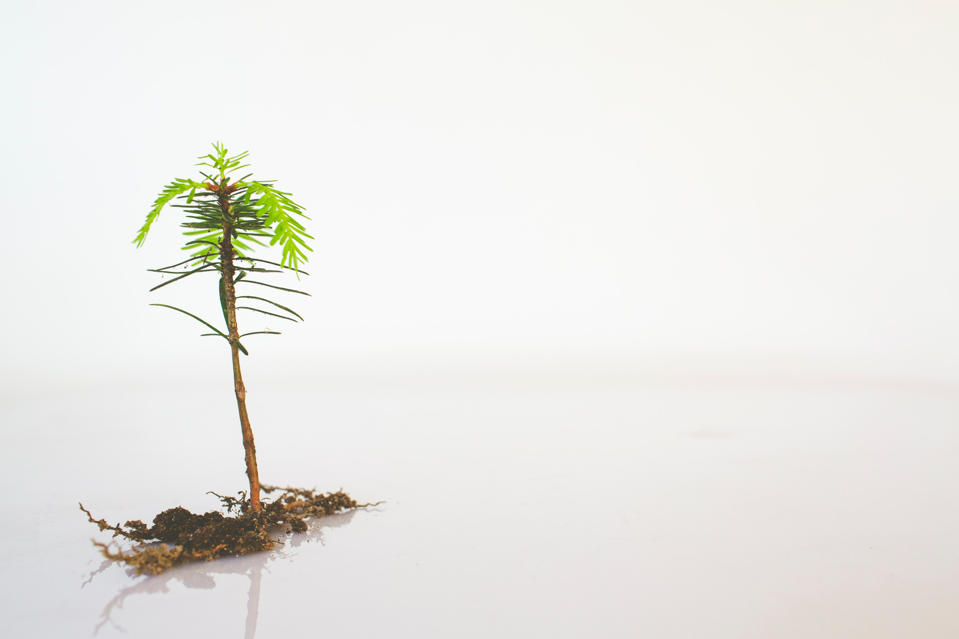
GROWING
Mark 1:14-20; Ephesians 2:1-10
Notes:
Good morning everyone. I hope you are all doing well. Today I’m sharing quite a simple message, there probably won’t be any new theology in here
It’s probably not going blow your mind, but what I will be sharing is an essence, a call to remember the gospel.
This morning I’m going to begin by confessing something to you
Too often in my Christian life have I sought to grow by my own strength and neglected the grace of God
Too often have I thought that if I just read my Bible a little more I will be a better Christian
Too often have I thought that if I just prayed a little longer I would be a better Christian
When I behave like this and think like this I always end up in despair because it never makes me a better Christian
You see that’s not the gospel. That’s not how we grow in Christ likeness. God uses His Word and prayer as the primary means to help us grow to become like Jesus, but when we approach it as a habit, as a work, as if somehow it earns my salvation then we are entirely missing the point of the gospel. We are entirely missing the power and grace of God that is in the gospel message
So as we look at this aspect of growing for the sake of sharing the gospel, I would like us to begin by taking a look at what the gospel is, and how our lifelong journey of becoming more like Jesus does not stem from our will and power but from God’s grace and power and us surrendering to His Will and the work of the Holy Spirit in our lives

Slide 2
WHAT IS THE GOSPEL?
There is ONE gospel (Gal 1:6-9)
“Once you were dead because of your disobedience and your many sins” (Eph 2:1)
We were condemned, subject to God’s wrath, deserving of hell for their rebellion against Him
Notes:
There is ONE gospel (Gal 1:6-9) - There is one gospel, and it is the gospel of old that is recorded in the Word of God - If anyone or any church proclaims anything else besides what is written in the Bible, they will be held accountable for that - I want to begin today’s message with what the gospel is, because ever since the gospel has existed, people have tried to contextualise it and make the gospel and God, into something that suits their needs and beliefs - But the gospel that changes lives today and is still true is this old, old gospel, and in this world that hates truth and rejects truth, we need to get a firm grasp on the gospel and hold on for dear life
“Once you were dead because of your disobedience and your many sins” (Eph 2:1) - Unbelievers, aren’t just sick, they are dead in their sins. Christians, before you believed in Jesus as your Lord and Saviour, you were dead in your sins - Paul gives us a dark picture of depravity, of just how lost believers once were. The hopelessness that we lived in and the darkness that consumed our lives - It’s an eerie picture of people living in a great graveyard of sin
We were condemned, subject to God’s wrath, deserving of hell for our rebellion against Him - We could not save ourselves, we were merely drowning in our sin - We could do nothing but live in constant disobedience - Following our own desires, our fallen nature, our own selfish inclinations, living only for ourselves. - I know this seems very dark and gloomy, but Paul wants his readers to understand the darkness that they lived in, because it is only when we see how hopeless and wretched and lost we were that we truly see just how awesome and loving our God is

Slide 3
“But God is so rich in mercy, and he loved us so much, that even though we were dead because of our sins, he gave us life when he raised Christ from the dead” (Eph 2:4-5)
It is by God’s grace that you have been saved, when you placed your faith in CHRIST ALONE
“He has created us anew in Christ Jesus, so we can do the good things he planned for us long ago” (Eph 2:10)
Notes:
“But God is so rich in mercy, and he loved us so much, that even though we were dead because of our sins, he gave us life when he raised Christ from the dead” (Eph 2:4) - In His mercy, God did not give us the death we deserved, because Christ died for us, instead in His grace, God offers us new life in His Son Jesus Christ who was raised from the dead - Sin, and Satan were working against us and trying to destroy us, but God was working for us, and if God is for us, then who can be against us?
It is by God’s grace that you have been saved, when you placed your faith in CHRIST ALONE - By no other name can you be saved - When we place our faith in Jesus Christ, in God’s grace, He says you are no longer condemned but my child - When we place our faith in Jesus Christ, in God’s grace, He says you weren’t righteous, but here have my Son’s righteousness - When we place our faith in Jesus Christ, in God’s grace, He says you were once lost, but now you are found, you were once dead, but now you have new life
“He has created us anew in Christ Jesus, so we can do the good things he planned for us long ago” (Eph 2:10) - Listen closely. We are not saved by good works, but for good works. - We are not saved by faith plus good works, but by a faith that works - We do not manufacture the good works, they are the result of the work of God in our hearts - Growing does not come from habits or performing good works out of duty, but out of a deeper understanding of God’s grace towards us, a deeper understanding of the gospel. When the gospel is what motivates us, it becomes a privilege to serve God not a chore, this is when the joy of the Lord becomes our strength - I want us now to move on to the passage in Mark, this is a real-life, biblical example of Jesus Christ being the motivator and the one who works in us to produce good works

Slide 4
FOLLOW ME
“Jesus called out to them, “Come, follow me…” (Mark 1:17a)
“Jesus called out to them, “Come, FOLLOW me…”
“Jesus called out to them, “Come, follow ME…”
Notes:
“Jesus called out to them, “Come, follow me…” (Mark 1:17a) - Back in the time of Jesus’, rabbis would normally wait to be approached and asked by a student if they could sit under them, and the rabbi would either accept or decline - Here, Jesus is not sitting back waiting passively, but beckoning his disciples to come and follow him - Jesus called normal fishermen, people from everyday life, because God involves Himself with everyday people - Jesus’s statement to Simon and Andrew is a command, and the implications of this command are extreme
“Jesus called out to them, “Come, FOLLOW me…” - Jesus calls them to FOLLOW him, as he does for us. But in saying this to them he is asking them to abandon everything and follow him - Jesus is saying lay down your nets and follow me. Leave not just your job, but your family too, the things of this world that you hold dear - We know from reading the Bible that following Jesus is not a comfortable life. We must deny ourselves, take up our cross, we are going to have to persevere and press on towards Jesus, Peter says we will need to make every effort - Paul nearly died for the name of Jesus multiple times and eventually did die for the name of Jesus. And we are told that if we follow Jesus people will hate us and mock us and persecute us. It’s a radical call, so we must count the cost
“Jesus called out to them, “Come, follow ME…” - The last thing I want us to notice in this verse is that they are called to follow Jesus himself - This is not a call to join a church, or a program, or an organization - They were called to follow a person, the Son of God, Jesus Christ the Saviour of the world - Our responsibility is to trust and follow, and as we will see in the next part of this verse; in Jesus we find everything that we need

Slide 5
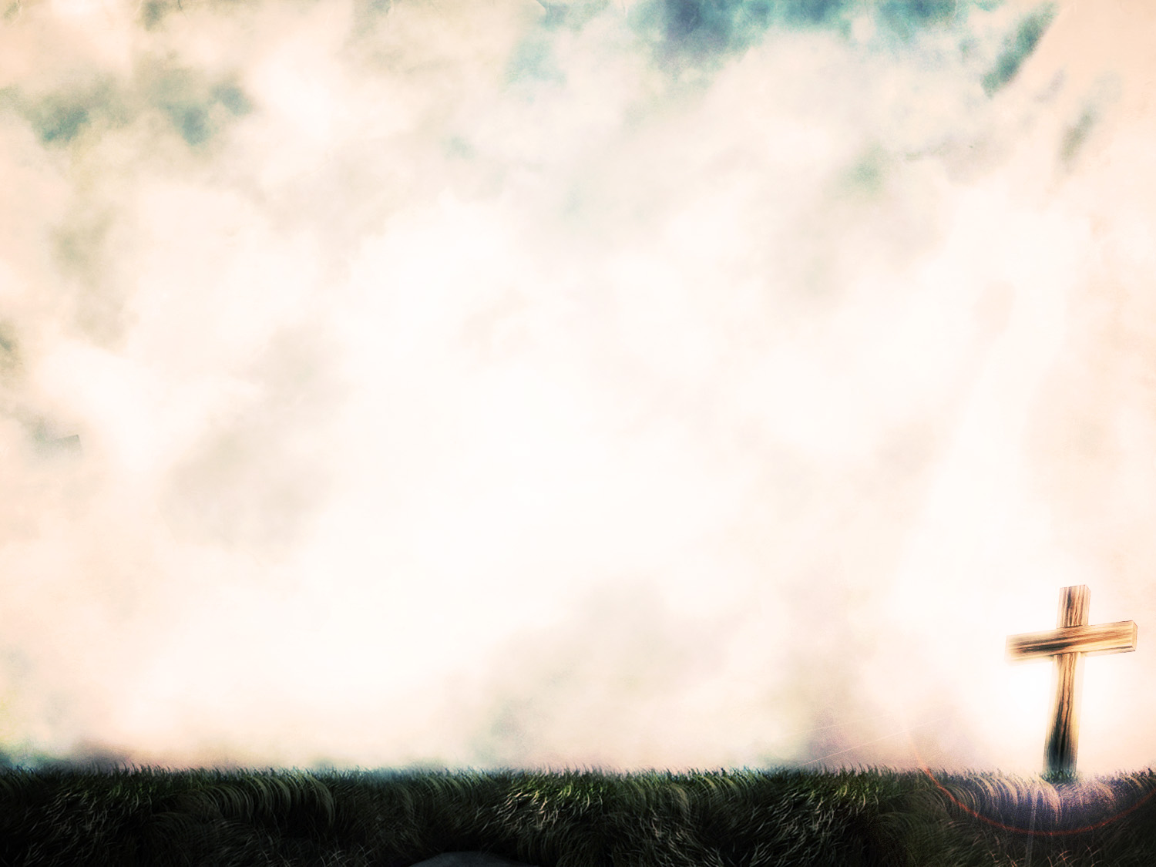
I WILL MAKE YOU
“… and I WILL MAKE YOU become fishers of men.” (Mark 1:17b ESV)
Salvation = belongs to God What we get wrong: Growing as a Christian = belongs to me
Only by the power of God can sinners, rebels, haters of God, be transformed into the likeness of Jesus
Notes:
“… and I WILL MAKE YOU become fishers of men.” (Mark 1:17b ESV) - The NLT says that Jesus would show them how to be fishers of men, but I think that the ESV and the more literal translations put it better by saying ”I will make you” - Jesus gives them a radical call, and if they should accept, he commits himself to completing this work in them - Jesus speaks of his side in this agreement that He will be the one to make them into fishers of men
Salvation = belongs to God. What we get wrong: Growing as a Christian = belongs to me - I think that theologically we would all agree that salvation is the work of God, and that apart from His work in my life I can do nothing good, that I could not hope to become more like Jesus apart from the power of God at work in my life - But practically I think a lot of us once we become Christians, go into productivity mode, trying to generate the fruit ourselves, and become like Jesus in our own strength. And we end up leaving God out of the picture - What we are saying is “I know that I could never save myself, but now that I am saved, this whole becoming like Jesus thing, the only perfect man to walk the earth, I got this, I’m good enough, I’m strong enough, I’m disciplined enough.” But that’s not the gospel
Only by the power of God can sinners, rebels, haters of God, be transformed into the likeness of Jesus - You and I are never going to be perfect sinless people until the day that Jesus returns and he calls us home - What hope do I have glorifying God and becoming more like Jesus Christ, and becoming all that GOD intended me to be, apart from the Holy Spirit at work in my life, apart from letting the living Word of God sink down deep into my heart and drawing me close to Him and His will in prayer - You can’t do the Christian life in your own strength, but that’s the whole point, you don’t have to, Jesus is saying “LET ME” - There was once a man who lived in 1800’s who put it really simply

Slide 6
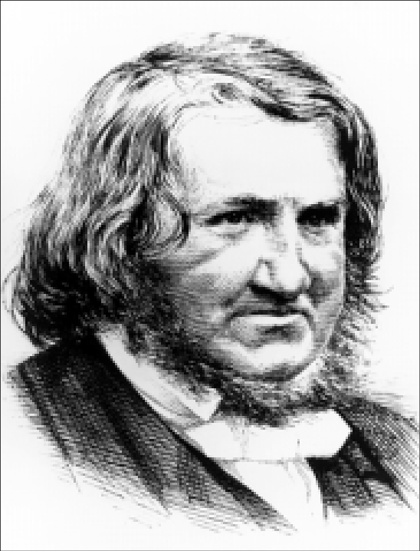
Sir James Young Simpson – 1811-1870
“I am a sinner and that Jesus is a great Saviour”
Notes:
He discovered the anesthetic properties of chloroform and pioneered it’s use in surgery and midwifery
Once a journalist was interviewing him and asked Simpson about his greatest discovery, now the journalist would have been talking medically but Simpson replied that his greatest discovery was that
“I am a sinner and that Jesus is a great Saviour”
I am a sinner, there is no good in me, but in Jesus we find all that we need. That’s what Jesus is saying here, come to me, follow me, I am all that you need, trust in me, abide in me, I will do great works in you for the glory of God

Slide 7
Our role is to obey His Word, and allow His Holy Spirit, His power, His grace to make us more like Jesus. We are to obey, commit, surrender
Until we give up any notion of entitlement, contribution, or partnership in salvation, we will never truly appreciate the work that God has done for us and is doing in us
God has worked FOR you, now let Him work IN you, that you may GROW to be more and more like His Son Jesus Christ
Notes:
Our role is to obey His Word, and allow His Holy Spirit, His power, His grace to make us more like Jesus. We are to obey, commit, surrender - I don’t want anyone getting the impression today that Christianity is a lazy passive faith. It is an active faith. Daily we are to surrender and commit our days to Jesus. - When the Word of God says we should do something we are to obey, and when it says we shouldn’t do something, we don’t do it, but it is the Holy Spirit that convicts us and steers us and guides us - If we do not obey the Word of God we quench the Holy Spirit. If we do not surrender, if we give no room for the Holy Spirit to work we won’t grow to be more like Jesus because it is only God’s power that can do this - If we do not remain in Jesus we will not grow, because it is Jesus working in us and through us that we grow to be more like him. We need to give up control of our lives and hand it over to Jesus
Until we give up any notion of entitlement, contribution, or partnership in salvation, we will never truly appreciate the work that God has done for us and is doing in us - Until we understand that it is by the grace of God alone that we are saved - Until we understand just how much our sin hurts God and cost God as Jesus was sent to the cross to die for us - Until we understand how hopeless our situation was, we will never appreciate the grace of God at work in us, and see that it is nothing that I do and everything that God has done in me.
God has worked FOR you, now let Him work IN you, that you may GROW to be more and more like His Son Jesus Christ - Satan was out to crush us, but God crushed Jesus so that you don’t have to be. God worked for you and said IT IS FINISHED. Now let Him work in you - Now Jesus says “Come, follow me, and I will make you fishers of men”. “By the power of God, by the Holy Spirit at work in you, I will make you more like me” - Why? So that we can bring glory to God, so that we can be a living testimony to God’s grace, so that we can have a loving, fulfilling relationship with our heavenly Father

Slide 8
OUR LIVES ARE INVITATIONS
When we let the power of God work in us, when we let His grace and love shown in Jesus Christ be our motivators, our lives become an invitation for others to follow Jesus as well
Jesus transforms us for God’s glory
Us growing in Jesus does not make disciples, but it does give evidence that our faith is genuine
Notes:
When we let the power of God work in us, when we let His grace and love shown in Jesus Christ be our motivators, our lives become an invitation for others to follow Jesus as well - God will use our transformed lives as an example to others of His grace and power - When people see actual change in someone they believe it. They see that something outside of themselves must have done this, that they must have something that I don’t - When God’s power changes us, when we are born again, we don’t just become nicer people, we become a new creation, the old has gone and the new has come. This gets people’s attention
Jesus transforms us for God’s glory - Listen, when Jesus transforms us, when we let him work through us and in us, it is not to bring glory to ourselves and never will, for our purpose in life is to bring glory to God alone - We need to remember that our will has no power to change us to be more like Jesus, but Jesus can and does, so trust in him, commit to him, obey His Word
Us growing in Jesus does not make disciples, but it does prove that our faith is genuine - McCrindle research did a report in 2021 on faith and belief and found what we all know to be true, that when we live a hypocritical life, a life that goes against everything we believe, people don’t believe our message, because clearly we don’t believe our own message - But when we live authentic lives founded in the Word of God and His power working in and through us, people are attracted to us. When people are attracted to us, we have the opportunity to share the gospel with them. Faith will not come by someone seeing our actions, but our actions will give us opportunities to share the same divine message that Jesus shared, which is “repent and believe the gospel”

Slide 9
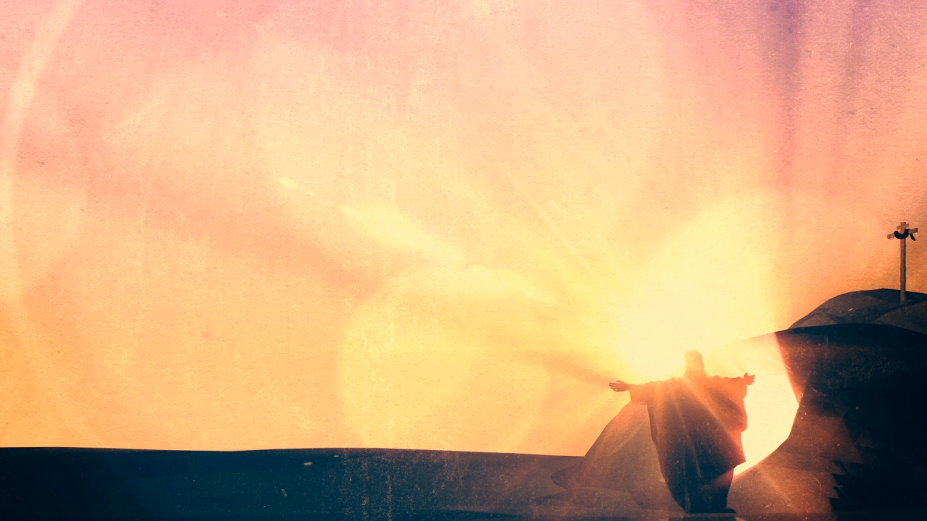
SUMMARY
PREACH THE GOSPEL TO YOURSELF
Being a follower of Jesus is not an easy path, but we don’t do it in our own strength
As we surrender our lives and obey His Word, becoming more like Jesus, people will be drawn to the message of the gospel
Notes:
PREACH THE GOSPEL TO YOURSELF - The gospel says that I am saved by the grace through faith. By the grace of God, Jesus was sent to die for me, and by placing my faith in him I am saved and born again - When we preach the gospel to ourselves we are constantly reminded of the fact that there was nothing I could do or can do to save myself - And it is by the grace of God and His power that I press on to reach the prize of eternity with my Lord and Saviour Jesus Christ
Being a follower of Jesus is not an easy path, but we don’t do it in our own strength - Jesus says there is one way and that way is through him. The way is narrow - But we do not walk this path alone. For it is no longer I who lives but Christ who lives in me
As we surrender our lives and obey His Word, becoming more like Jesus, people will be drawn to the message of the gospel - As we live by faith and live our lives to the glory of God, Jesus will shine forth - As we abide in THE light of the world, we will be A light to the world - As we keep growing in the likeness of Jesus, the gospel message will go out into this world that so desperately needs it

Slide 10
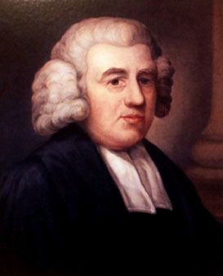
“Yet, though I am not what I ought to be, nor what I wish to be, nor what I hope to be, I can truly say, I am not what I once was - a slave to sin and Satan; and I can heartily join with the Apostle, and acknowledge; By the grace of God, I am what I am!”
Notes:
Today I want to finish, hopefully leaving you in awe of God’s amazing grace, and His amazing power, and His amazing love shown on the cross
Today I pray that God would be drawing you close by His Spirit and in His grace. That we might leave here and live lives fixated on the gospel, remembering that it is Christ who lives in and through us and that the grace of God is at work in our lives
And what better way to do that than to quote John Newton, the famous hymn writer, the man who wrote Amazing Grace. He once said this
“I am not what I ought to be! Ah! how imperfect and deficient! - I am not what I wish to be! I 'abhor what is evil,' and I would 'cleave to what is good!' - I am not what I hope to be! Soon, soon, I shall put off mortality: and with mortality all sin and imperfection!
Yet, though I am not what I ought to be, nor what I wish to be, nor what I hope to be, I can truly say, I am not what I once was - a slave to sin and Satan; and I can heartily join with the Apostle, and acknowledge; By the grace of God, I am what I am!”
It is by the grace of God that we grow to be more like Jesus. It is by the grace of God that I am what I am!
Let’s pray

