Slide 1
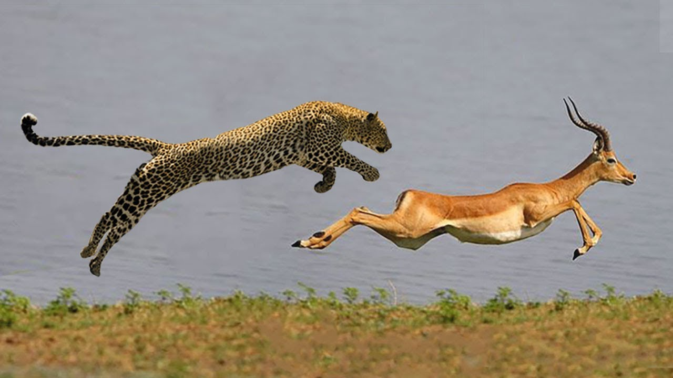
The African Impala can leap 3m high x 30m long & run 90 kmph when in danger.
Yet it can be held captive in a zoo with a 1m high wall???
If they can’t see what’s on the other side, they won’t jump.
Life transforming, God pleasing faith helps us to get through the trials of this life & to do great things for God.
Notes:
The book of Hebrews (which we started last year and will finish in term 2 this year) is written to a people struggling with the realities of living in a sinful, broken world – facing intense opposition and danger and feeling trapped and hopeless. In a sense Hebrews is an intense counselling course to help people face the trials of this life. One of the key ways to do that is to be a people of faith. It helps us to deal with the trials of this life. It is also faith which helps us to live a life which is pleasing to God.

Slide 2
GOD CAN’T BE PLEASED WITHOUT
“It is impossible to please God without faith....” (Heb 11:6)
HEBREWS
10:32 – 11:16
GOD PLEASING (GENUINE) FAITH IS = Rational + Persuasive + Foundational + Grace Fueled
IS
IT
Notes:
Hebrews 11:6 tells us that is impossible to please God without faith. But what is faith? Our world tells us that faith is a feeling, having a positive outlook on life or believing in yourself. But what is God pleasing faith? Today we will see that it is 4 things – rational, persuasive, foundational and fueled by grace.

Slide 3
GOD PLEASING FAITH IS RATIONAL – “Faith shows the reality (being sure) of what we hope for; it is the evidence (validated, proven certainty) of things we cannot see.” (Heb 11:1)
Faith is not wishful thinking, a blind leap, trusting in something with no facts, superstition, the enemy of reason or science…
“By faith we understand that the entire universe was formed at God’s command, that what we now see did not come from anything that can be seen.” (Heb 11:3)
The current options for ‘understanding’ the cause of all that exists = a designer & creator (God), a big bang (randomly, out of nothing) or an eternal universe (it has just always existed).
Notes:
While its true that I can’t see God but God has given us a wonderful visual proof of his existence. In verse 3 the author reiterates a relationship between faith and rational thought (understanding). By faith we understand = it is very rational to conclude that at the very beginning there must be a cause for all that exists. Things don’t just happen. There is design, order, beauty and purpose in creation – evidence certainly points to a designer and creator, to God. When the world considers the big question of how did our universe begin, what is its purpose , where is it going etc. there are currently three major options – God created, evolution which requires a big bang that randomly happened out of nowhere or a relative new theory (because they realise the struggle in justifying, proving a big bang) is an eternal universe theory which is that it has always just existed (no need to explain a beginning). Now in reality which of those options is the most scientific, the most believable? Which option requires the biggest leap of faith?

Slide 4
“They know the truth about God because he has made it obvious to them… through everything He created… So they have no excuse for not knowing God.” (Rom 1:18-20)
“If you look for me wholeheartedly, you will find me.” (Jer 29:13)
Option 1. God doesn’t exist = no order, no purpose (all is meaningless) & there is nothing beyond this life = there is nothing more important than putting my hope in ‘me’ & ‘now’.
Option 2 “.. God does exist & He rewards those who sincerely seek him.” (Heb 11:6) = it would be foolish not to take Him at His word & there is nothing more important than my personal relationship with Him (He is my hope, my joy and my life).
Notes:
Creation alone gives us every reason to put our faith in God – there is no excuse if we don’t. God promises time and time again that if you seek me you will find me (Jeremiah 29:13, Isaiah 55:6, Matthew 6:33) If we don’t find God, put our faith in him then we aren’t seeking enough. That means that when it comes to faith we ultimately have two options. We can either suppress the truth and believe that God doesn’t exist – that we don’t need any god to rule our lives – we can rule ourselves, make life all about me, I decide what is right and wrong and I will live for this life only. Or there is a God and my relationship with him is vital to me. God pleasing faith is not just believing God exists. It must desire a relationship with him – God pleasing faith is not just rational. It must also be –

Slide 5
GOD PLEASING FAITH IS PERSUASIVE (HEART)
The heroes of the faith didn’t just believe in God (even demons do that – James 2:19), they put their faith in God = a personal, ‘heart’ encounter which persuaded them to live for Him.
Not always a dramatic or definable moment for us & our faithfulness will grow gradually – “we walk by faith” (2 Cor 5:7).
“Faith by itself isn’t enough. Unless it produces good deeds, it is dead and useless.” (James 2:17)
Faith is active & radical (never passive) – being persuaded to follow God’s call (even if it doesn’t make sense).
Notes:
There are 16 heroes specifically mentioned in Hebrews 11 and they all believed God, not just believed in the fact God exists. Even the demons do that (James 2:19). Its not enough to just believe in God – we have to be persuaded, have a personal encounter with God. Our faith must move us to follow and obey God. To live for Him. This encounter will be different for each of us. Some will know exactly when the knowledge of God overwhelmed their heart (surrendered to Him). We will also not be super heroes in our faithfulness immediately following the moment we surrender our heart to him. Paul said we walk by faith and not by sight – walking is something we learn and get better at. Babies don’t just walk perfectly straight away. They stumble, hold onto things and take time to get stronger and more confident. Same in Christian faith – it is a growing process. But make no mistake about it – true, God pleasing faith is active. It is a clear and certain sense that God is coming into your life and saying I want you to follow me. And every believer is asked to follow God – to do great things for Him. Not just for super Christians. We all have a purpose, a mission field, a gift, an opportunity and a step to take for God.

Slide 6
Hebrews 11 = faith is not just a feeling. It is also a doing.
Brings a proper sacrifice. Walks with God. Builds an ark in the desert. Goes out without knowing where. Dwells in tents in a foreign country. Looks for a city made by God. Receives strength to give birth well past child-bearing age. Offers up one’s son in obedience. Blesses others and worships while near death. Chooses to suffer with God’s people. Leaves Egypt for the Promised Land. Passes through the Red Sea. Walks around the walls of Jericho till the walls fall down. Gives shelter to spies. Subdues kingdoms. Shuts the mouth of lions. Quenches the flames. Rules with justice. Escapes the edge of the sword. Receives the dead back to life. Wanders over deserts and mountains. Hides in caves. Receives the promises of God.

Slide 7
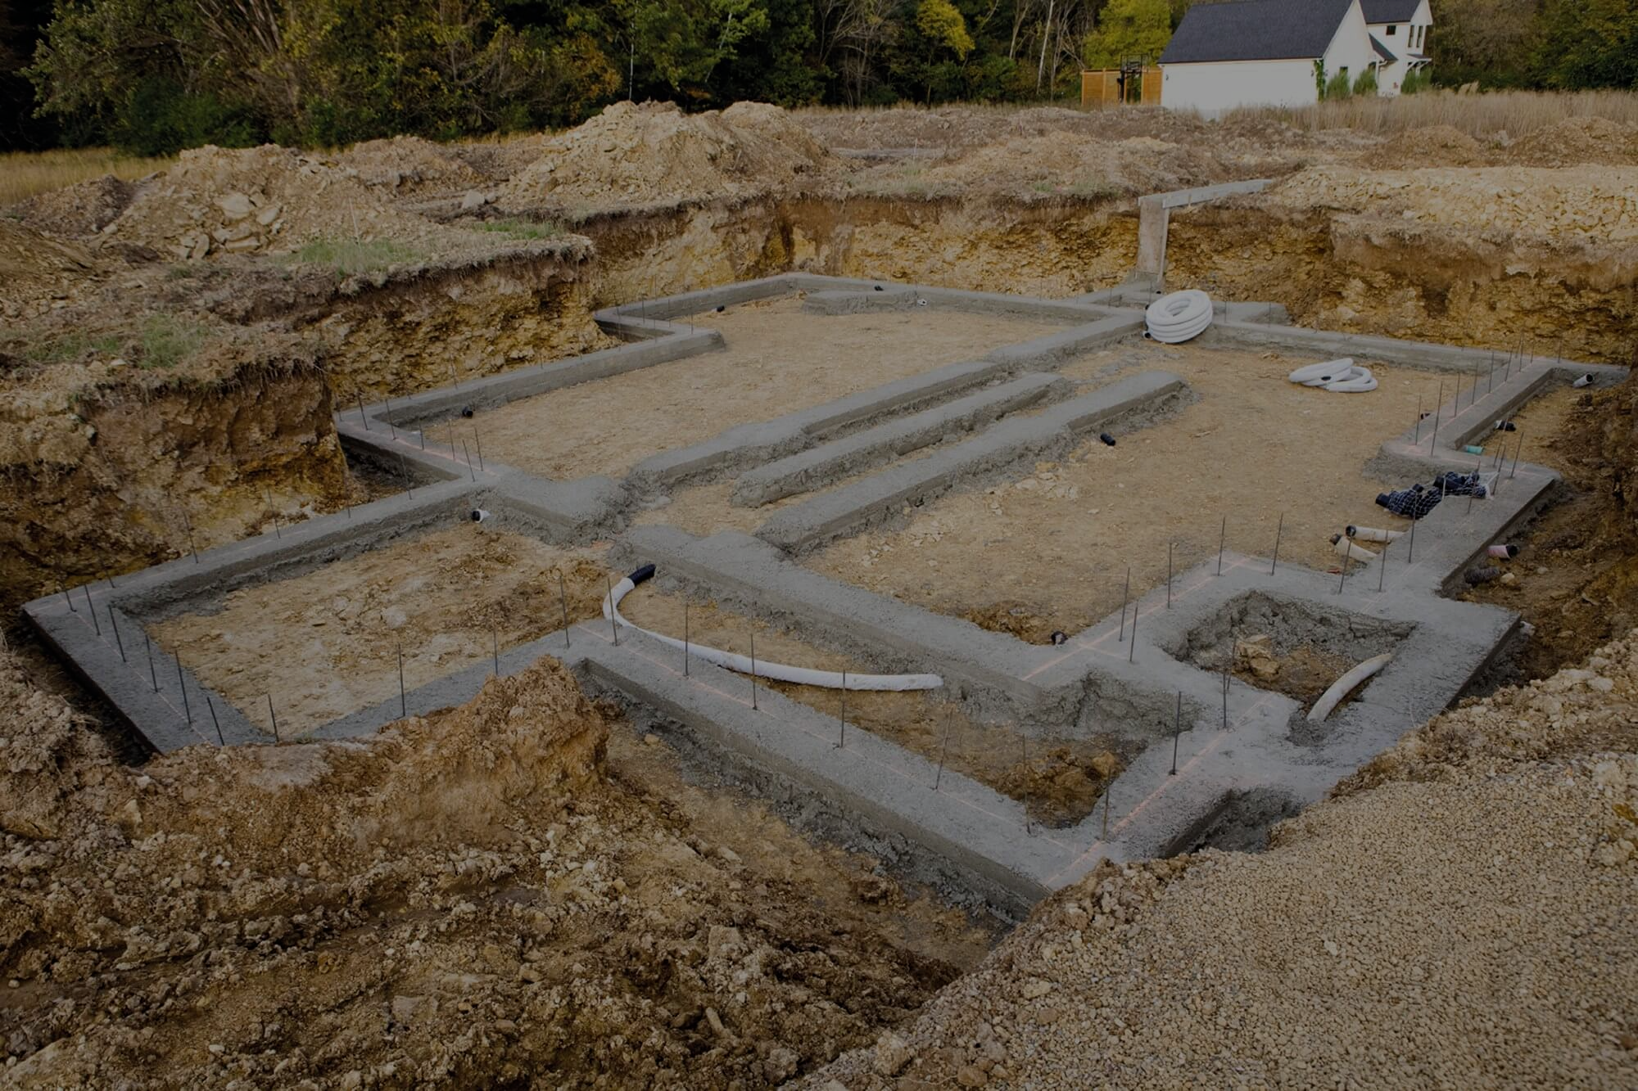
GOD PLEASING FAITH IS FOUNDATIONAL
God – “Get out!” Abraham – “Where?” God – “I’ll tell you later. Just go!”
God – “Settle down!” Abraham – “When!” God – “I’ll tell you later. Just keep wandering.”
God – “I will give you a son!” Abraham – “How? My wife and I are old.” God – “I’ll tell you later. Just wait!”
God – “Sacrifice the son you love.” Abraham – “Why?” God – “I’ll tell you later. Just start going up the mountain.”
God was training Abraham to have a faith which would be “confidently looking forward to a city with eternal foundations, a city designed and built by God.” (Hebrews 11:10) -
Notes:
From this point on want to focus on Abraham – the father of our faith (Galatians 3:6-7) - no wonder because God tested him a lot. What is God doing here? Training Abraham to understand that there is no foundation in this world that we can build our life on - find our joy and hope.

Slide 8
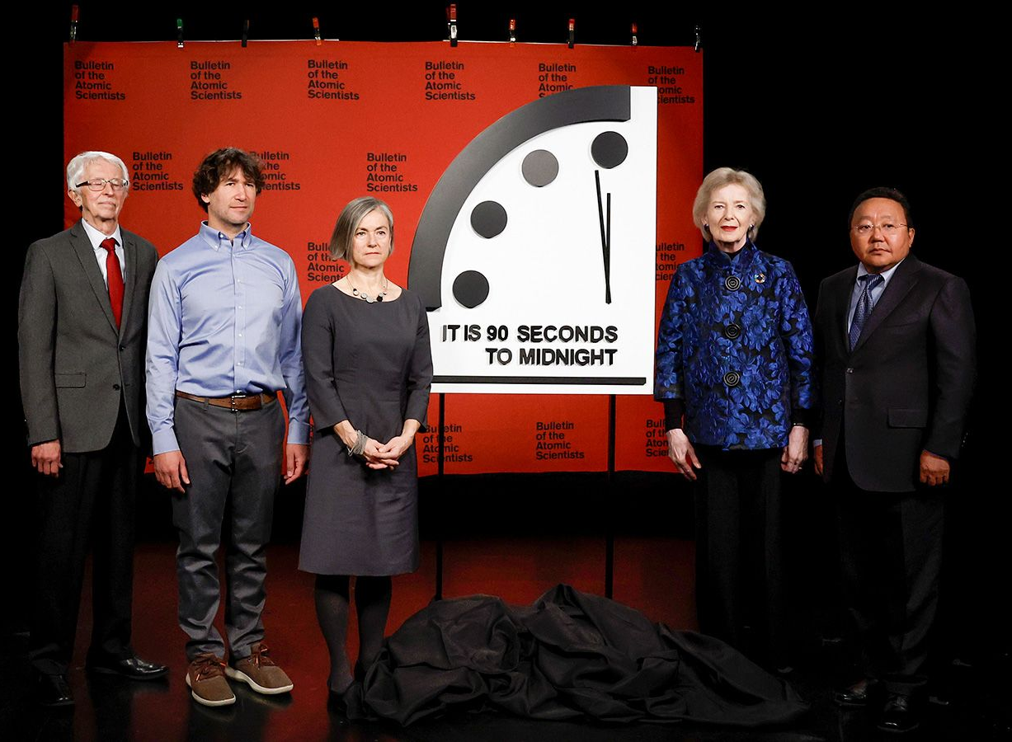
God said to Abraham, the same thing he says to us. “Obey me & leave that behind. Put your faith in me alone. Don’t build your life on the things of this world (family, career, looks, money, reputation…) because it will all go.”
“God pleasing faith is shifting the centre of the gravity of your life away from the things of this world. It is building your foundation on God, His word and His future. It is the only way you will be unshakeable, even in the midst of chaos.” (T Keller)
A faith founded on God = believing Him enough to go, trusting Him enough to wait and fearing Him enough to sacrifice.
Notes:
Even secular scientists agree – the world is winding down, everything is gradually falling apart – its all unravelling and all that we know will be destroyed. Doomsday clock was started and maintained since 1947. The clock is a metaphor for threats to humanity from unchecked scientific and technological advances. It started at seven minutes to midnight and has since been set backward eight times and forward 17 times for a total of 25. It was most recently set on January 24, 2023 to 90 seconds to midnight – the closest its ever been. God pleasing faith is difficult but don’t despair because there is an answer for you.

Slide 9
GOD PLEASING FAITH IS GRACE FUELED
“Lord, how can I be sure that I will actually possess the land you promised me.” (Gen 15:8) – How can I trust you? How do I trust me?
GOD’S PREMIUIM GRACE
God made a covenant with Abraham, but only God walked between the animal carcasses. (vs 9-21)
God says – “If I don’t keep my promises, I will pay the penalty. When you fail to keep your promises I will also pay the penalty.” = “My grace is your assurance.”
Jesus says - “Your father Abraham rejoiced as he looked forward to my coming. He saw it and was glad.” (John 8:56)
Notes:
At one point on his faith journey Abraham was filled with doubt and asked the question we understandably ask ourselves often. How can I be sure? I know that my faith will fail often and how do I know you won’t abandon me – call it off because of my failure, because I don’t live as I should, I break my word and commitment to you. What if my faith in you fails? In response God told Abraham to get some animals and cut them in half so that he could make a covenant (unbreakable agreement) with Abraham. I know that sounds very gruesome and weird to us today, but in those days and in that culture that’s how agreements and contracts were sealed. The two parties would slaughter some animals, cut them in half and then both would walk between the carcasses and state the terms of the agreement – what their responsibilities were. The symbolism if this act was that both parties were essentially saying, “This day I make this promise and if I don’t keep my promise then may I be treated the same as these animals.” But an amazing thing happens is that God puts Abraham into a deep sleep and in the form of a smoking pot and flame, God is the only one who walks between the carcasses. What does that mean? God is taking all the risk, willing to cover all the penalty (even ours). This is perfect grace. Abraham knew how wondrous this promises was and its why Jesus said Abraham rejoiced when Jesus came because he knew Jesus was the ultimate fulfillment of God’s promise to take his penalty and everyone else’s penalty – the ultimate expression of grace. God’s grace covers us when our faith fails.

Slide 10
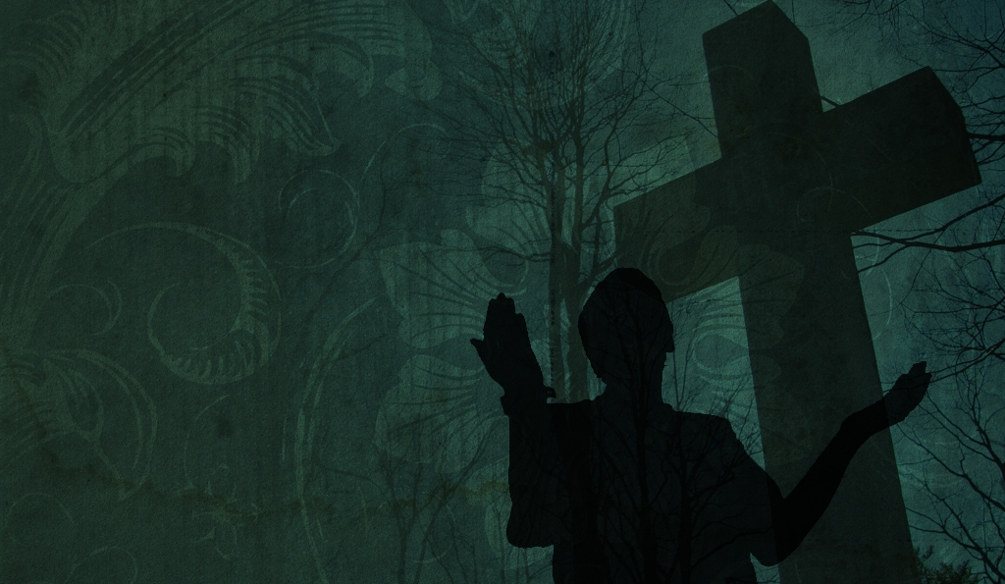
Jesus had the ultimate security & status in heaven. But in faithfulness to God, he was willing to get out of there & give up everything – to suffer & sacrifice himself for us.
Jesus asks us to do the same – to go out & be faithful even if it means losing the ‘foundations’ of this temporary world.
Failing in your faithfulness doesn’t = losing your salvation or the promises of God. God’s grace = unwavering confidence for us..
“God saved you by his GRACE when you believed. And you can’t take credit for this; it is a gift from God. Salvation is not a reward for the good things (faithfulness) we have done, so none of us can boast about it.” (Eph 2:8-9)
Notes:
Jesus owned nothing – no possessions, no home, no family, no wealth and gave up everything – glory, comfort, security, reputation (human approval), and life. He asks us to do the same. And don’t despair because God’s grace has got us covered when our faith weakens, even when it fails.

Slide 11
God pleasing faith starts rationally, then becomes persuasive, then slowly turns you into something great by changing your foundations & is inspired by the grace of God.
God pleasing faith is not easy. It is a call away from the security, approval, comfort & peace of this world. It is often a call into uncharted territory.
You don’t know where you are going but you know who you are going with = Jesus the creator & ruler of the universe & the one who gave everything for you.
“I’ve been given all authority in heaven & on earth… be sure that I am with you always, even to the end of the age.” (Matt 26:18-20)
Notes:
Story of man falling off roof – is anybody else up there. (Believe and let go). God pleasing faith is not easy and can often be quite scary. But Jesus is with us always. We are never asked to follow him alone.

