Slide 1
COURAGE
FAITH
KNOWLEDGE
LOVE
SELF CONTROL
PATIENCE
GODLINESS
“You are afraid of mere humans, who wither like the grass and disappear? Yet you have forgotten the Lord, your Creator….” (Isa 51:12-13)
FORGIVENESS
HEALING
GRACE
MERCY
LOVE
POWER
SUPREMACY
“But those who fail to develop in this way are shortsighted or blind, forgetting that they have been cleansed from their old sins.” (2 Pet 1:9)
“Let all that I am praise the Lord; with my whole heart, I will praise the Lord…may I never forget the good things he does for me.” (Psalm 103:1-2)
Notes:
As we face another New Year, I am sure many of you are like me and setting new goals to try to be more effective in our Christian life. Less fearful, more faithful, loving, knowing, self controlled, patient and godly. In reality we probably set these goals every year and every year struggle to make great progress in these areas. Time and time again we find ourselves paralysed by fear, doubts and shame of Why? Well Bible tells us we struggle in these areas because we are prone to forget about God – who He is and what He has done for us - so obviously not a new problem and challenge for Christians. The great Bible hero David obviously struggled with this and his solution is to preach to your heart. In Psalm 103 he isn’t talking to God or others (except for a very few verses). He is talking to himself – preaching to himself. Its easy to know God in our mind but its another thing to know him in our heart – which is what ‘remembering’ in the Bible is all about. Its repeatedly telling yourself the truth until your heart grabs it and holds onto it – until your heart catches fire with this truth. Its talking to your heart and soul. It’s rewiring your mind. Its intentional meditation and contemplation, repeatedly praying and speaking the truth to yourself. Not just quietly but out loud too. David is encouraging us to talk to ourself – which psychologists know helps. “Talking to yourself helps to clarify your thoughts and understand what’s important and firms up any decisions you are contemplating.” (Linda Sapadin) As David talks to himself he finds confidence and strength and reason for worship in remembering the many things God does for Him - including some blessings God gives us, by not doing things with our sin. Which is what I want to focus on today.

Slide 2
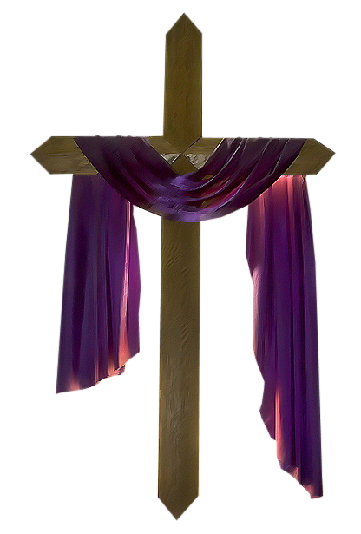
“THINGS GOD CAN’T (WON’T) DO WITH OUR SIN, BECAUSE …..”
(Psalm 103:8-12)
Notes:
As we continue in our series about the things that God can’t do and how that helps us to have a happy New Year, we are looking today at the things God can’t do with our sin. But unlike the other things we have looked at, there is a condition which has been satisfied which forces God’s hand not to do these things – which is why I have added ‘because’ on the end. And we must remember that today as well.

Slide 3
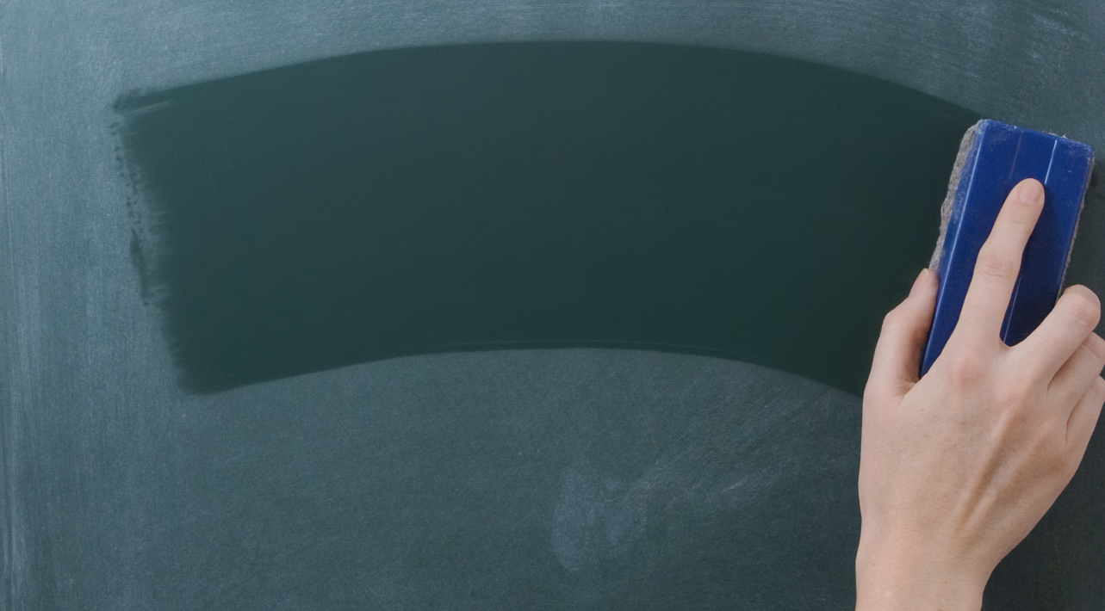
HE REMOVES OUR SIN AND NEVER REMEMBERS OUR SIN – “He has removed our sins as far from us as the east is from the west.” (Psalm 103:12)
East from the west = infinitely separated, never able to come to together.
A statement of complete & utter forgiveness, we’re never held to account. God never stews over, analyses or seeks revenge for our sins.
“For I will forgive their wickedness and will remember their sins no more.” (Hebrews 8:12)
Notes:
He removes our sin – David uses the analogy ‘as far as east is from the west”. If you look to the east and then look to the west how far apart are they? Now go towards the eastern horizon for 5km, 50km, 1000km etc. Now stop and look around. How far is the eastern horizon from the western horizon? Still infinitely apart. Doesn’t work with north and south because we have put arbitrary points to identify the north and south poles. Go towards the north pole far enough and eventually you hit it and you start to head south. And vice versa. But east and west like that. No defined point – infinitely apart, always going east or always going west – it never stops. East from west is an awesome illustration of the fact that God removes our sin and never brings them back. Unlike us, he never brings up past offenses, he never gets vindictive or revenge. God adds to this imagery of east from west by declaring in His word (also Isaiah 43:25, Jeremiah 31:34) by adding that once he forgives our sins then he never remembers it. The problem we often have is that we forget the last two words and let Satan lies and accusations steal our joy, haunt us, paralyse us with shame and guilt.

Slide 4
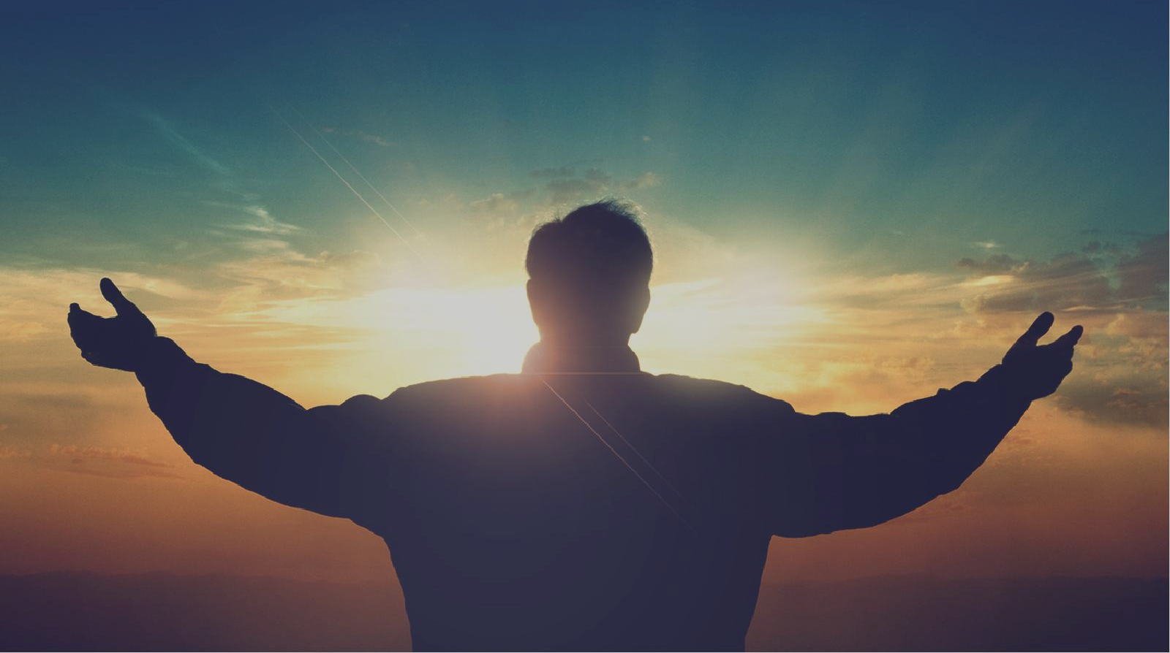
No more = we shouldn’t be paralysed or discouraged by guilt & shame. We should never listen to Satan’s lies and accusations (not loved, not forgiven, no hope, too wicked, disqualified ….)
Not that we aren’t guilty – just that we are forgiven. Not that God can ‘forget’ (omniscient) but He chooses to not remind himself of our sin & He will not remind us of it either.
“He will not constantly accuse us, nor remain angry forever.” (vs 9) = conviction of sin & loving discipline to wake us up, get us back on track & to ‘work all things for good’ (relational).
It’s never payback, retribution or condemnation (judicial, eternal).
Notes:
Too often we listen to Satan’s lies about our sin. Too often we ask for forgiveness but doubt that we are forgiven. We hang onto the sin when God forgives it, removes it and never remembers it. It’s not that we aren’t guilty, we are just forgiven. It also doesn’t mean that God really forgets things. He is omniscient – he knows all things past, present and future. He can’t learn and he can’t forget. But in his mercy and grace he chooses to not remind himself of our sin. But what about verse 9 = he will not always accuse us (which means he will sometimes accuse us) and he won’t remain angry forever? This is relating to the fact that God will convict us of our sin and discipline us (just as he did with King David – last week’s message). But this is relating to our relational position with God, not our judicial/eternal position. Judicial/eternal position is our salvation and status as child of God and that is never in doubt. That is through what Christ has done, not us. But our relational experience, day to day relationship with God can change if we hold onto sin and don’t confess it. We can lose the joy of our salvation and peace of salvation. But as any good and loving Father should do God will get angry and look to discipline and convict/challenge us because he loves us. He does this to wake us up, get us back on track and keep us going again. But its never retribution, its never payback. Its to work all things for our good. It is relational, never judicial or eternal (impacting our salvation). It can’t be payback or retribution because David also tells us God can’t punish us as we deserve - which is our next thing God can’t do with our sin.

Slide 5
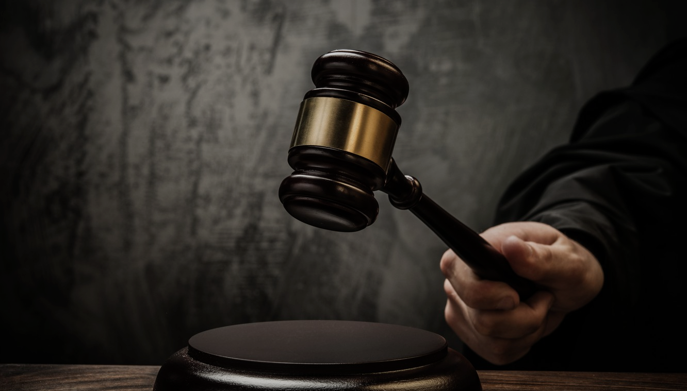
GOD CAN’T PUNISH US AS WE DESERVE – “He does not punish us for all our sins; He does not deal harshly with us, as we deserve.” (Psalm 103:10)
We may love recording wrongs & getting revenge (don’t get mad, get even) – but our good & gracious God doesn’t do that to us.
Doesn’t mean that God just ‘winks’ at sin (Rom 6:23), that God is more loving than just, or that God won’t discipline us (relational).
“Blessed is the one, whose sin the Lord does not count against them..” (Psalm 32:2) = keeps no written record of our sins in order to get a guilty verdict & condemnation (judicial, eternal).
Notes:
Consider how we deal with others. We are always mindful of injustices against us and often very good at nurturing and holding onto the memory of others faults and failures. We hold it in our hearts and over their heads and justify that is only fair we treat them that way. Its justice as they are getting what they deserve. But God doesn’t act that way. It’s not that he doesn’t care about our sin and wickedness – he doesn’t just wink at sin, that it doesn’t matter that much. And its not because he is more loving than he is just. And its not because our sin doesn’t deserve to be punished – in fact it deserves the most severe and eternal punishment. What it does mean is probably best described by David in Psalm 32:2 – God doesn’t count it against us. This means he doesn’t keep a record of our sins to condemn us. He never comes into the court room with a ‘charge sheet’ on which he has recorded every sin we have with a view to getting a guilty verdict. Once again remind you that this is in relation to our eternal, judicial position with Him – our salvation. Repeated and unrepentant sin will impact on our relational experience with God and he will discipline us if necessary. But when it comes to our salvation and eternal relationship and security with God – no condemnation or separation from God (Romans 8).

Slide 6
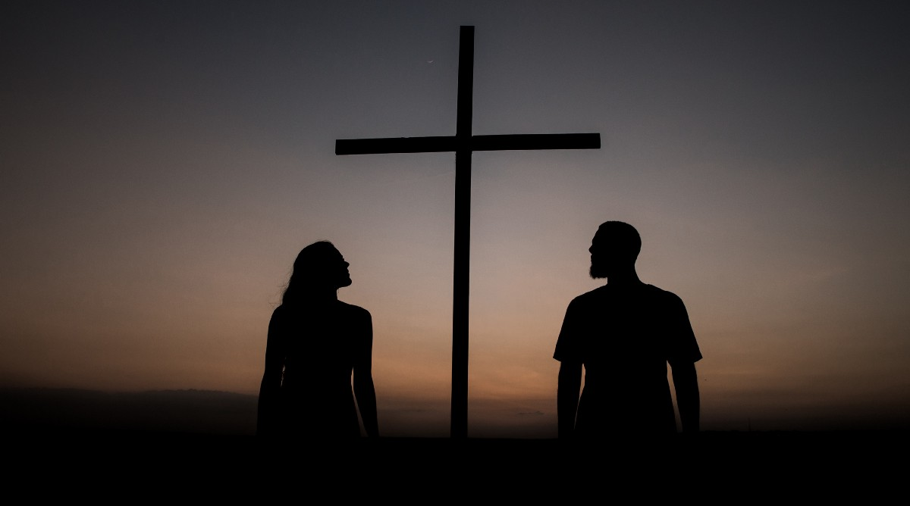
So why does our holy God remove our sin? Why can’t he remember our sin? Why won’t He punish as we deserve?
BECAUSE….. OF WHAT JESUS DID FOR US ON THE CROSS.
David’s context was the promise of the perfect sacrifice & scape goat onto whom all his sins would be placed (Lev 16:20-23).
Our context is the cross = the fulfilment of OT types & symbols.
“But he was pierced for our rebellion, crushed for our sins. He was beaten so we could be whole. He was whipped so we could be healed. All of us, like sheep, have strayed away. We have left God’s paths to follow our own. Yet the Lord laid on him the sins of us all.” (Isaiah 53:5-6)
Notes:
The cross, and the cross alone is the reason why we can rejoice and praise God – why we can sing and celebrate that God does not and never will deal with our us according to our sins. The wonderful truth of penal substitution is important for us to hold onto. If God did’t pierce and crush Jesus for our sin, then he would have had to crush and pierce us. If he didn’t forsake Jesus and turn his face away from him on the cross, then he would have had to forsake us and turn away from us. If he didn’t deal with Jesus according to our sins, then he would have had to deal with us. If he didn’t lay our sins on Jesus then he couldn’t remove them from us.

Slide 7
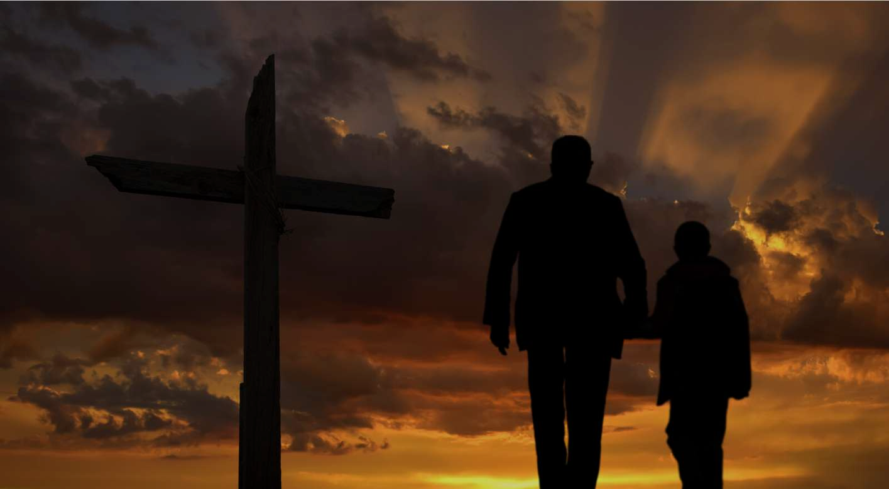
The cross, and the cross alone is the reason why we can rejoice and praise God – why we can sing and celebrate that God does not, and never will, deal with us according to our sins.
The measure of Gods ‘unfailing and immeasurable love towards those who fear Him’ (Psalm 103:11) is the price of the sacrifice he endured in giving up His only son to suffer in our stead.
“Since he did not spare even his own Son but gave him up for us all, won’t he also give us everything else?” (Rom 8:32)
“All my sins, struggles and failures are forgiven, covered and paid in full by the marvelous, infinite, matchless grace found in the atoning work of the cross of Jesus Christ.” (Matt Chandler)
Notes:
We have no reason to live a fearful, uncertain, hesitant, hopeless, joyless and powerless life for Jesus.

Slide 8
What would your Christian life look if you woke up each day, went about your daily routine & went to sleep at night, with the absolute confidence that because of the cross (Jesus) –
God will never remember your sin & wicked deeds.
God will never repay you or deal with you as you deserve.
You will never lose the love and promises of God our Father.
To truly know that & take hold of it in your heart = experiencing all the joy, power, love, peace, promises & presence of God = indescribable, immeasurable and too marvelous for words.
NO. 1
Notes:
Today I would like to close with two challenges. Challenge 1 is for those who have surrendered their lives to Jesus as the Lord and Saviour, to those who know Jesus Christ as their Lord and Saviour - to those You get these blessings not because you don’t sin nor deserve death. But because our debt has been paid, our sin is covered and forgotten because of the blood of Jesus. We have no reason to wallow in guilt, be paralysed by fear and shame or be uncertain about the future. We have no reason to doubt our worth – we are children of God.

Slide 9
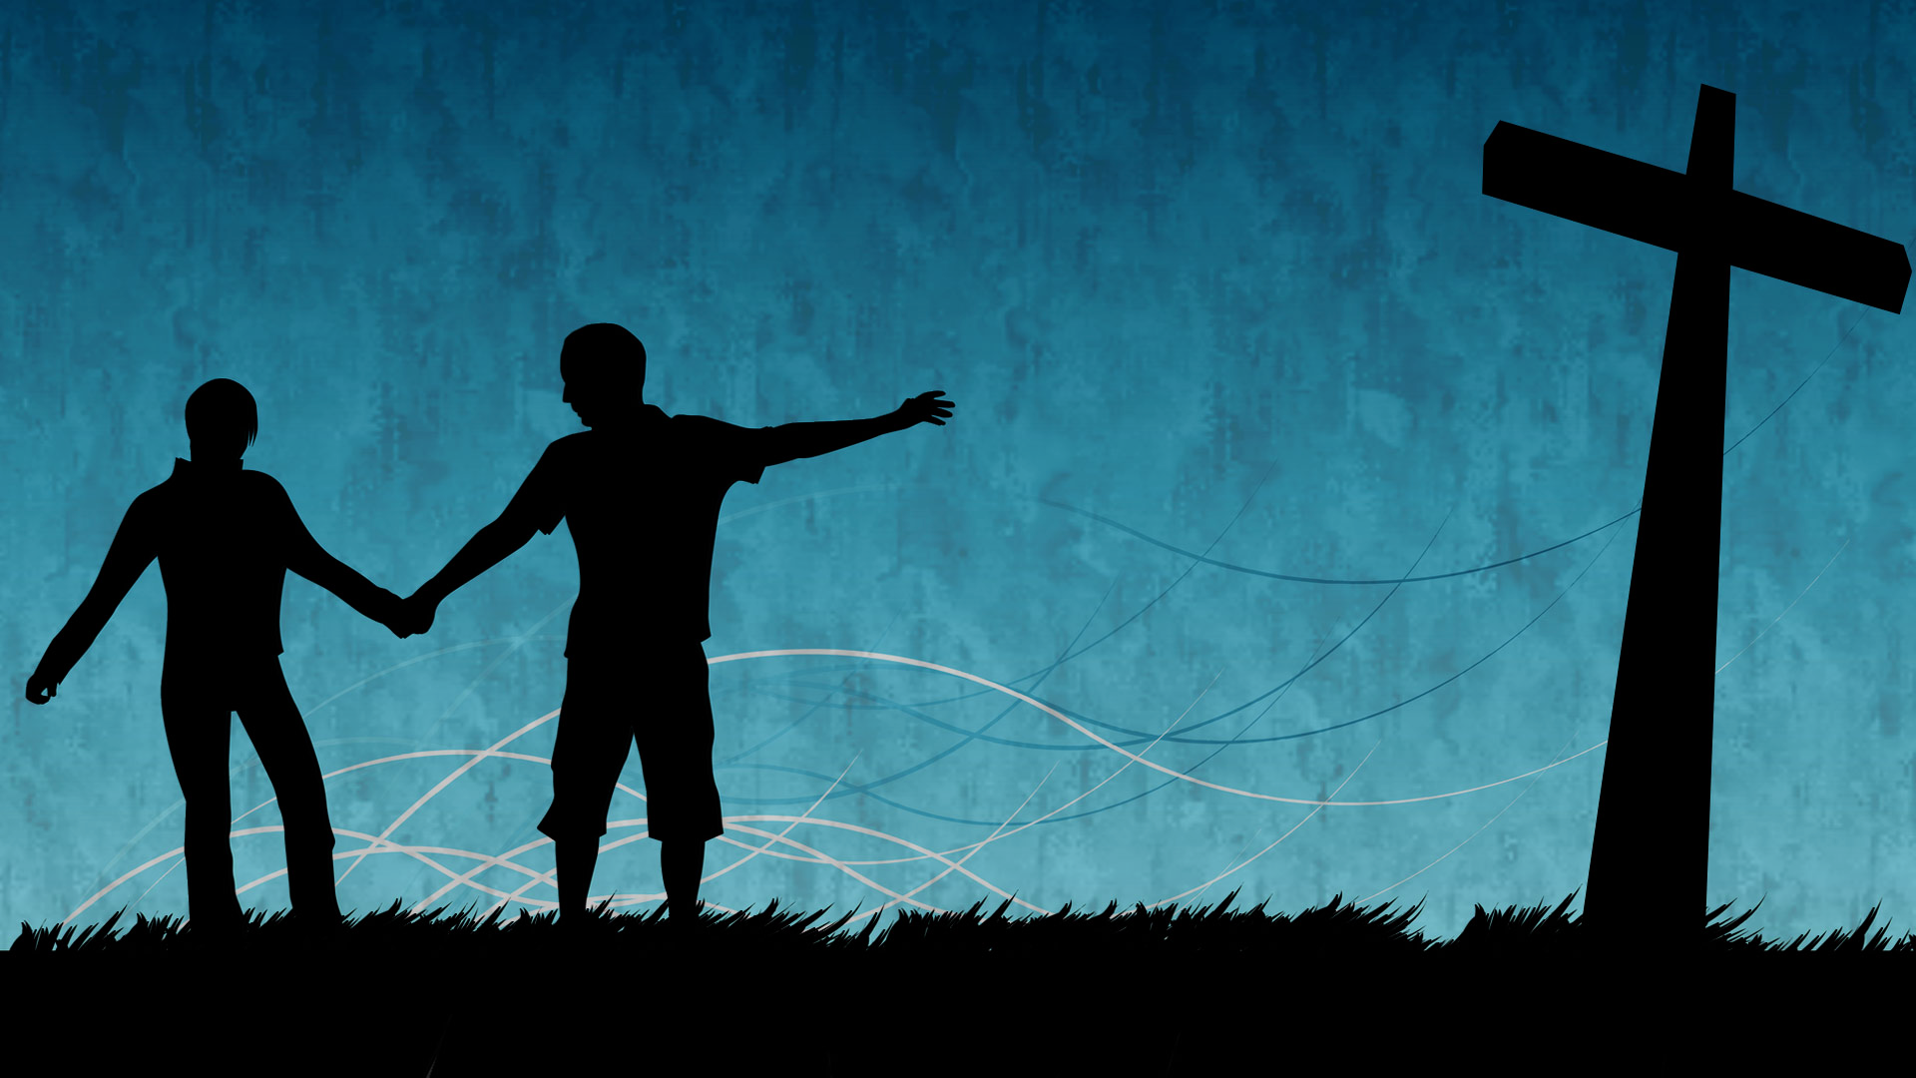
NO. 2
Do you agonise over your sin and wicked deeds? Do you live with guilt & shame and in constant fear of God’s judgment? Do you desire for God to never again remember your sin or repay you as you deserve? Do you long for a confidence, peace, hope, love, joy and blessing which can’t be taken away?
Jesus offers himself as a sacrifice for your sins = He has satisfied the justice & wrath of God.
Acknowledge your need for a Saviour, repent of your sins & put your trust in Jesus = God’s promise, “For I will forgive your wickedness and will remember your sins no more (forever).”
Notes:
If you say yes to those questions then I have an offer for you – in fact Jesus has an offer for you. He offers himself for you. Through his sacrifice on the cross he has atoned for all your sins. The very moment you repent and accept Jesus, you will not be rejected. As we learnt last week, God can’t reject a broken and contrite heart. From that moment God will forgive you and never, ever remember your sins and count them against you.

