Slide 1
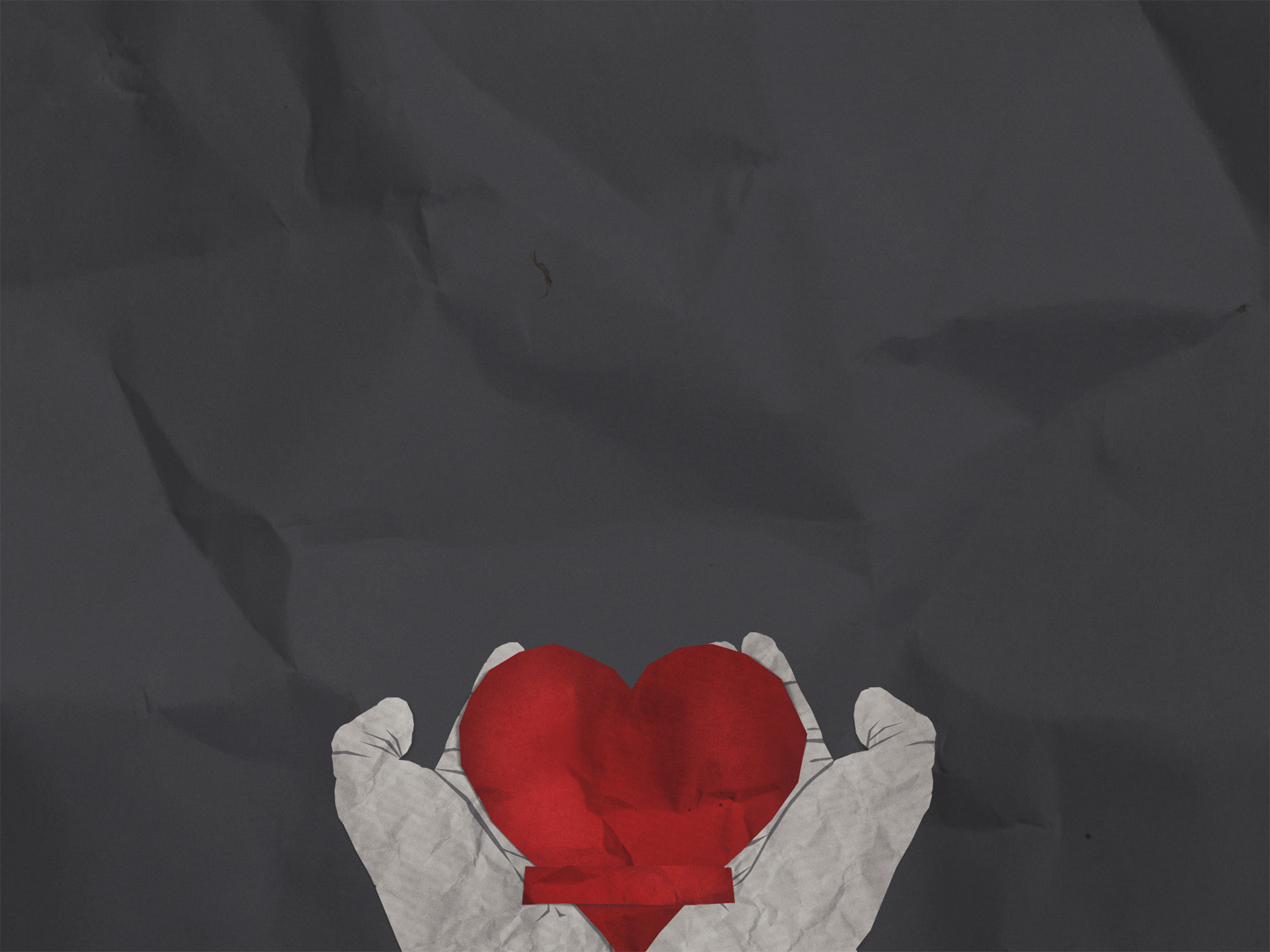
GOD WILL NOT REJECT A BROKEN AND REPENTANT HEART
Psalm 51
Notes:
Good morning everyone. I hope that you have all had a good week
Today we are carrying on with our series, and we are looking at the fact that God will not reject a broken and repentant heart
If there’s things in your life that you know need to change but no matter how hard you try nothing seems to change, the reason is you need a broken and repentant heart
The heart of the gospel is that we have all fallen short of God’s standard, but because of Jesus Christ, we have a way, and we approach Him and receive salvation by faith and continually draw closer to Him with a broken and repentant heart
And we can approach with confidence knowing that God will accept it because of the life, death and resurrection of Jesus
And in Psalm 51 we have this beautiful, very real and raw picture in king David of what a broken and repentant heart looks like
But first let me deal with a few nuanced elements before diving into this passage
This is a prayer that could be uttered by someone who is coming into relationship with Jesus Christ, receiving salvation, but this was written by someone who already has a relationship with God
This is not David asking for his salvation back, rather the prayer of backslidden follower of God who has lost his closeness with God and the joy of his salvation, but has not lost his salvation in and of itself
Secondly, today’s sermon is not a step-by-step guide to effective repentance, rather it is an example of the heart attitude that should be present when we truly repent from sin
But before we jump straight into the Psalm let me give a little context

Slide 2
NATHAN REVEALS DAVID’S SIN
David had committed adultery, he ordered murder, he lied and was trying to cover it all up
God sends Nathan to tell David a story (2 Sam 12)
David sees the sin in his life and we are given this very real prayer of repentance
Notes:
David had committed adultery, he ordered murder, he lied and was trying to cover it all up - All it took for sin to get a foothold in David’s life was a glance across the roof and he ended up sleeping with Bathsheba and got her pregnant - He tried to cover that up by bringing home Uriah, the husband, one of his mighty men, to sleep with her, but Uriah was too honourable to do that while his warriors were suffering out on the battlefield - So David put together a strategy to have him killed on the battlefield - And as you can imagine this obviously displeased the Lord, so God does something about it, but not to condemn, but rather to bring David back to Him
God sends Nathan to tell David a story (2 Sam 12) - Nathan tells David a story about 2 people one rich and one poor. The rich man owned lots of sheep and cattle, but the poor man had nothing but one precious little lamb, and he treated this lamb with such love and tenderness - But one day the rich man has a guest over and wishes to provide a meal for the guest, but instead of using an animal from his own herd he steals this poor mans one lamb and prepares it for his guest - David upon hearing this story is furious and says that the rich man should die for his crimes. But Nathan stops him and says to him “David, you are that man” - Here was a man of great leadership qualities, who had been given the kingdom of Israel by God, a man of incredible devotion to God, a great king, a musician, a poet, a man of courage and character - David was one of the main ‘prototypes’ in the Bible of Jesus himself, Jesus comes from the line of David and is referred to as the Son of David, he was a man after God’s own heart - I know we think “well I would never do anything like that”, and I pray that we don’t. If you’re sitting there thinking that you are above these sins, that you are stronger than David was, then I ask that you examine yourself and be very careful of the pride that is lurking in your life - If David is capable of this, if David needed this wake-up call, if David had this kind of heart, if sin could blow up his life like this, you don’t think it could happen to you?
David sees the sin in his life and we are given this very real prayer of repentance - This is one of, if not the greatest prayer of repentance you will read in the Bible - We see in this Psalm that no matter how much you may ruin your life, God can bring new life. No matter how far you fall, God can bring you back up - No matter how broken you are, because of what Jesus has done on the cross, you can be made whole

Slide 3
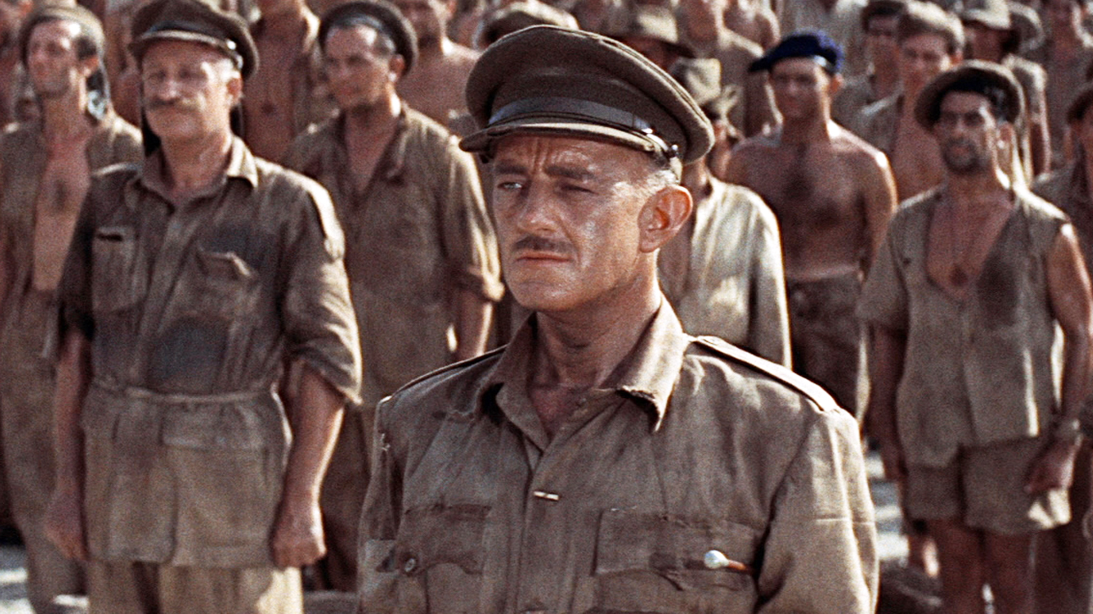
Notes:
This is a picture from the movie ‘Bridge Over River Kwai’, and I must confess I have never seen this movie, as it was a little bit before my time
But in this movie Alec Guinness plays a British officer who builds the bridge over river Kwai, and he has forgotten that he has betrayed his country, his country’s values. He has come over to the other side. At the very end he betrays and kills some of his friends to save the bridge
Then suddenly it dawns on him, and he says, “What have I done?” When the enormity of what he has done hits him, there’s only one thing for him to do. He goes to run over to blow up his own bridge and is shot down on his way, and dies stumbling and falling onto the detonator for the bridge, pretty much as an atonement for his sin
Don’t do this, when you see your sin, don’t fall into self-pity, that’s what Satan wants, and he wants to keep you there. David could have done this, David was at a very low point in his life, but when struck with the enormity of his sin he fell into the arms of his loving Father, and so too should we

Slide 4
DAVID TURNS TO GOD
“Have mercy on me, O God, because of your unfailing love. Because of your great compassion” (Psalm 51:1)
David throws himself into God’s arms because he knows that God is his only hope
David comes to God as he is, lays it all out in the open
Notes:
Have mercy on me, O God, because of your unfailing love. Because of your great compassion” (Psalm 51:1) - I love that this Psalm begins with David’s plea and total reliance, completely falling upon God’s mercy, and love, and compassion - The opening plea of “Have mercy”, is the language of someone who has no claim to the favour they beg for, he sees that he is not worthy of what he asks and yet does so anyway because he knows God - He goes from covering up his sin, to being called out, to just falling into the arms of God and calling upon the character of God - This Psalm describes how David felt as he laid hold of God’s mercy
David throws himself into God’s arms because he knows that God is his only hope - And he does this because he knows that his only hope of a restored relationship is by the mercy and grace of God - David is depending on God’s steadfast, unfailing, covenantal love. He is looking back on all the times when God in His justice could have destroyed Israel because of their sin, but didn’t because of His covenantal love - David knows the character of God and is allowing the grace of God to come into his heart - And just as God’s love, compassion, mercy and grace are David’s only hope for a restored relationship so too is it for us as sinners, so too is it for us as Christians when we fall into sin
David comes to God as he is, lays it all out in the open - This is a warts and all kind of prayer, David isn’t sugarcoating anything, he comes to God and hides nothing - He goes from asking himself “How can I cover up my sin?” to asking “How could I treat God, the One I love like this?” - He comes to God vulnerable and willing to do whatever it takes to be drawn close to God again - He knows it’s going to hurt, he knows God will have to cut deep, but all he wants is to be close to God again - In order to get close to God again… (David confesses the seriousness of his sin)

Slide 5
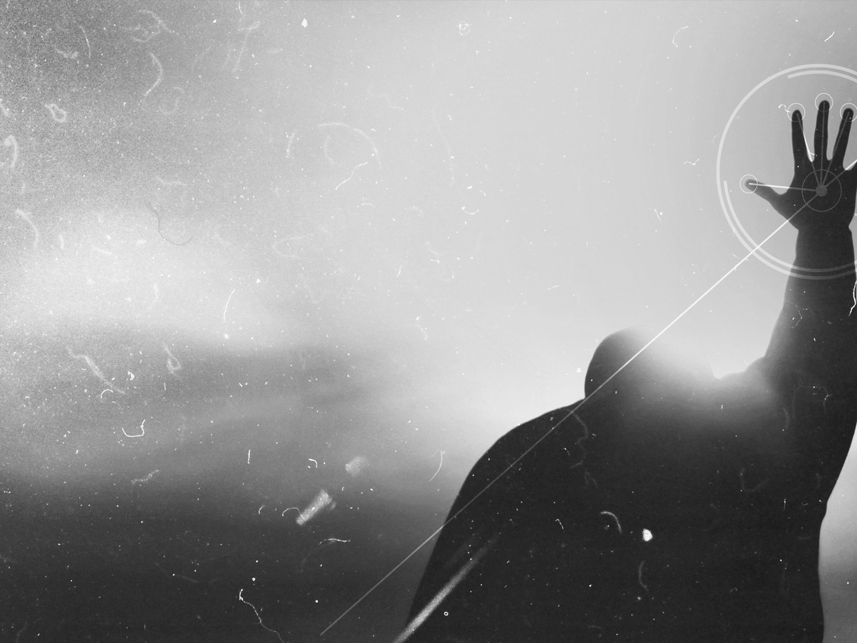
DAVID CONFESSES SERIOUSNESS OF HIS SIN
”For I recognise my rebellion, it haunts me day and night” (Psalm 51:3)
“Against you, and you alone, have I sinned; I have done what is evil in your sight” (Psalm 51:4a)
“You will be proved right in what you say, and your judgement against me is just” (Psalm 51:4b)
Notes:
“For I recognise my rebellion, it haunts me day and night” (Psalm 51:3) - Or in other translations it says “For I know my transgressions, and my sin is ever before me” - He is saying I get it God, I see just how wicked I am, I see how much I have hurt you, I see how I have placed other things before you in my life and it haunts me, I see how I’ve put distance between you and me and it is ever before me - Repentance means cutting down far enough so you can get the whole thing out. You have to let God cut down deep enough. He has to cut in all the way so He can cut it out all the way, and so that’s what David is doing by seeing his sin as God sees it
”Against you, and you alone, have I sinned; I have done what is evil in your sight” (Psalm 51:4) - Now this verse does not mean that David did not sin against Uriah or Bathsheba, but an acknowledgement that sin is first and foremost against God, sin is an attack on God, it defies God, it is a belittling of Him - David goes so far as to say I have been this way since birth, not as an excuse, but to say that I am by nature this way and if you don’t rescue me, I know that I will do more and more evil - Here’s what David is saying. He says, “Yes, I sinned against your law, but mainly I sinned against you. Yes, I trampled on your rules, but mainly I trampled on your heart. I have sinned against a loving and compassionate God, and that’s what breaks David’s heart
“You will be proved right in what you say, and your judgement against me is just” (Psalm 51:4b) - Whilst David would hate it, he is willing to accept whatever judgement God gives him. If God were to cast him into hell, God would be innocent, if God were to sentence him to death, God would be innocent, because these were sins that required death according to the law - God would be just to damn David, and David knows it, and knows that the only reason he is still breathing is by the mercy of God - David doesn’t make excuses or offer ifs and buts, unlike Adam and Eve in the garden when they were confronted with their sin, Adam admitted he sinned but put some blame on Eve for offering the apple to him, and Eve admitted she did wrong but blamed the snake for tricking her - Circumstances and people can shape the sin, but they don’t cause the sin, we choose to sin. That’s why David takes full responsibility, there are no ifs and buts to be seen here. This is deep, godly sorrow which leads to repentance

Slide 6
We need to take full responsibility for our sins. There are no ‘ifs’ and ‘buts’
We have to see our sin as it really is. We only do that by seeing it as God sees it
David views his sin and fills his heart with the love and grief of God
Notes:
We need to take full responsibility for our sins. There are no ifs and buts - There is no shifting the blame - When you do take full responsibility, then change begins - We need to be willing to admit that we sinned, that the cause of my sin was me
ILLUSTRATION – If you see a log on the ground and pick up one end but keep the other on the ground and try to throw it, it will go nowhere - The only way to throw a log is to put the whole weight on yourself, and then you can throw it away. Unless you take it fully on, you will never be able to take it fully off - A lot of people think they repent, but haven’t actually taken on the full responsibility, the full weight of their sin so that they can give it all over to God. Unless you see your sin as it really is, unless you look at Jesus on the cross and see your sin for what it is, you will never throw it fully into God’s arms and we need God’s help for this
We have to see our sin as it really is. We only do that by seeing it as God sees it - God hates sin, our sin put Jesus on the cross, our sin separates us from His love - Our sin caused separation between Him and His one and only Son - Don’t miss the seriousness of your sin, but we mustn’t stay here either
David views his sin and fills his heart with the love and grief of God - David is saying that what makes this wrong is that I broke God’s heart, that I trampled on Him, I need to repent because I’m trampling on the love, and grace of God - When we view sin through the lens of God’s mercy, love and compassion, this is not only the thing that convicts us, but brings us back to Him - If we are sorrowful because we are fearful of the consequences of sin, we may stop for a while, but we won’t completely get rid of the sin. - We will end up in despair again, because we will try and deal with the sin in our own strength and we will be depressed. David comes to hate the sin, but not himself, because he fills his heart with the goodness and grace of God and how much he has hurt his heavenly Father who loves him deeply

Slide 7
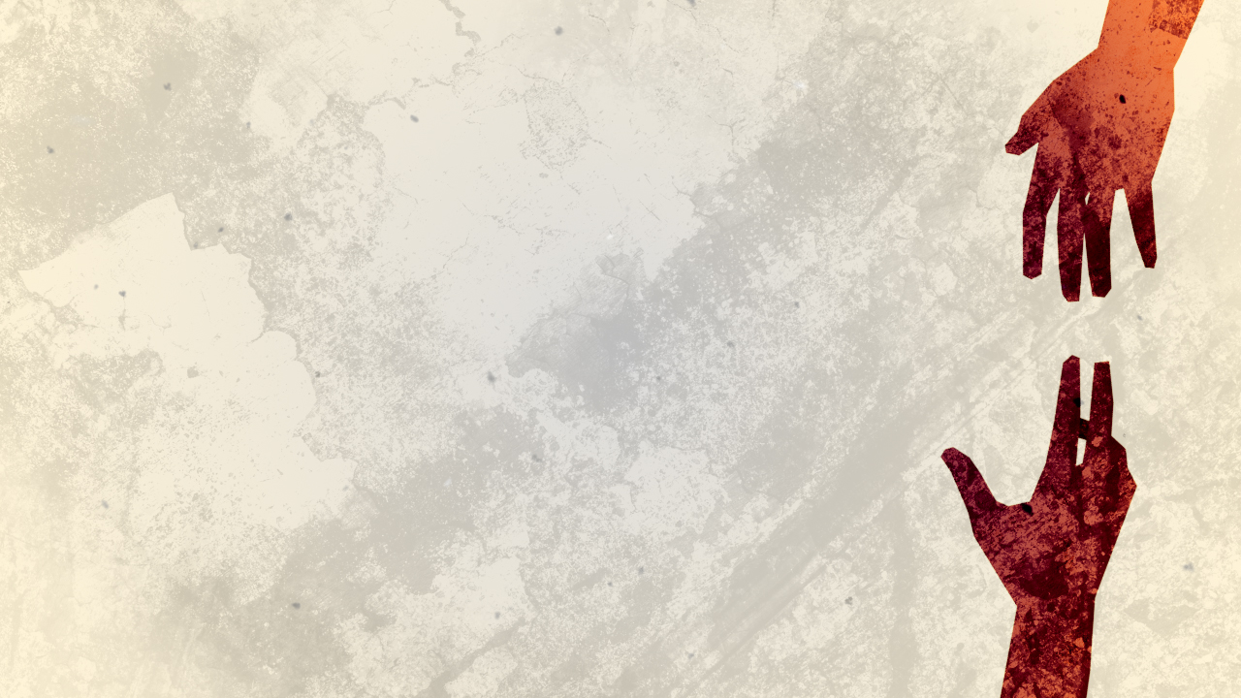
DAVID PRAYS FOR CLEANSING
“Purify me from my sins, and I will be clean; wash me, and I will be whiter than snow” (Psalm 51:7)
David is seeking restoration of relationship and realises this will only happen if God hides His face from David’s sin
David falls helplessly on the mercy of God and prays that in His mercy that God would forgive him and make him clean
Notes:
“Purify me from my sins, and I will be clean; wash me, and I will be whiter than snow” (Psalm 51:7) - 7 times David asks for forgiveness in this Psalm - In other translations it says purge me with hyssop. Hyssop was the branch used by priests to sprinkle blood on a house that had a disease in it, like leprosy, to declare it clean - David is crying out to God knowing that He is His only hope, as his ultimate priest to count him as clean from sin, to declare him innocent - As Christians it is by the blood of Jesus that we are washed clean. Christ has purchased our forgiveness, he has paid the full price for it. - That does not replace our asking but rather is the reason we are so confident that the answer to our plea will be a resounding yes, you have been made clean
David is seeking restoration of relationship and realises this will only happen if God hides His face from David’s sin - God hiding his face would normally have been a sign of divine anger and rejection, in the way that God had to turn His face away from Jesus - But that’s exactly why we can find cleansing and restoration. Because Jesus took our punishment and died in our place, and took on our sin, meaning God had to hide his face from Jesus for the first time in eternity. This happened so that God would not turn His face away from us, but from our sin
David falls helplessly on the mercy of God and prays that in His mercy God would forgive him and make him clean - There is no power within David to cleanse himself or forgive himself, it has to be something, someone outside of himself, and the only person that can provide forgiveness is God - I think that you’re probably starting to see the picture - Repentance is us coming to the end of ourselves and giving it all over to God. It is all an act of God’s divine mercy and grace. Repentance is not about how good a Christian or person you are, but how awesome and merciful our God is - David doesn’t just need forgiveness and reconciliation though, but also transformation

Slide 8
DAVID PLEADS FOR RENEWAL
Forgiven people are committed to being changed by God and for God
“Create in me a clean heart, O God. Renew a loyal spirit within me” (Psalm 51:10)
David asks that God would make him willing to obey, he will go and teach God’s ways, he will joyfully sing praises. He asks God for a renewed life
Notes:
Forgiven people are committed to being changed by God and for God - Forgiven people don’t want to keep living a life that hurts God - They want to live a life that is pleasing to God, they want to live a life that will bring Him glory - True repentance does not and cannot stop with cleansing, it always lead to a change in your life
“Create in me a clean heart, O God. Renew a loyal spirit within me” (Psalm 51:10) - The word here for create is the same as what is in Genesis 1:1 – In the beginning God created the heavens and the earth - It is used exclusively in the Old Testament for divine activity - David is asking for nothing short of a miracle. To take his sinful wretched heart and make it into something new, make it into something that will please God and keep him close to God
David asks that God would make him willing to obey, he will go and teach God’s ways, he will joyfully sing praises. He asks God for a renewed life - These are not things that can be accomplished apart from the work of God in our lives. David knows that he can’t just try harder, he needs a radically new start - You see this progression in the Psalm from a man on his knees in agony and grief over how much he has hurt God, his one true love, and it’s almost as if we begin to see David stand - Ready to go out and live a life completely devoted to God once again, live a life out of the joy of his salvation, live a life shouting at the top of his lungs, the goodness, and grace, and unfailing love of God

Slide 9
“You do not desire a sacrifice… The sacrifice you desire is a broken spirit. You will not reject a broken and repentant heart, O God” (Psalm 51:16-17)
You see your sin, you admit your sin, you grieve over your sin, you forsake your sin. What will follow is a new life of intimacy with God
Notes:
“You do not desire a sacrifice… The sacrifice you desire is a broken spirit. You will not reject a broken and repentant heart, O God” (Psalm 51:16-17) - Being a Christian means being broken and contrite. Don’t make the mistake of thinking you get beyond that in this life - A broken and repentant heart marks the life of God’s happy children till they die. Having this attitude, having this kind of heart is not against joy and praise and witness, it’s the flavour of these things - What looks like defeat to the world, this idea of repentance, stripping yourself down, admitting the worst, admitting you’re a sinner, the thing that the world says is weak, that will destroy you is actually the way to resurrection, is actually the way to allowing the power of God to take root in your life and drive you forward in doing His will for His glory
You see your sin, you admit your sin, you grieve over your sin, you forsake your sin. What will follow is a new life of intimacy with God - When you get this, when you truly repent, your life will be transformed - The reason we can live a life of intimacy is because not only did Jesus die for our sins, but he rose again so that we may have new life - That’s the gospel. The gospel is that if you will turn to God, if you will come to God, WHICH IS REPENTANCE, and place your faith in Jesus Christ, you will be cleansed, you will find forgiveness, but not only that He gives you new life, and life to the fullest - And when we distance ourselves from God, He will always call His children back to Him, back to repentance, like He did with His servant David.

Slide 10
SUMMARY
Repentance always means turning to God
Repentance sees the seriousness of sin
Repentance cries out for forgiveness
Repentance will bring about renewal
Notes:
Repentance always means turning to God - The very definition of repent is to turn, to do a complete 180, and so we turn from our sin and look towards God instead - And we do so knowing that our heavenly Father is there waiting with arms open wide,
Repentance sees the seriousness of sin - No matter how big or small, our sin is what put Jesus on the cross - Our sin is the reason God sent His one and only Son to die for us
Repentance cries out for forgiveness - We don’t deserve it but in God’s grace we can have our slates wiped clean by the blood of Jesus - We can find forgiveness if we are willing to repent
Repentance will bring about renewal - Repentance doesn’t stop at forgiveness - The fruit of repentance is always a renewed life because we hate the idea of hurting our heavenly Father - So we are willing to let go everything the world has to offer in order to cling to Jesus Christ, in order to cling onto our relationship with God - This kind of repentance will always bring about renewal

Slide 11
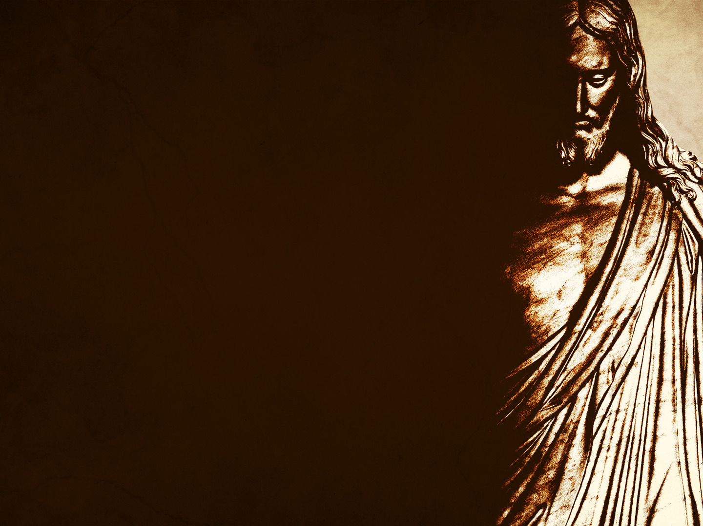
“Son, I’m going to tell you something I’ve never told anyone else, and I never will again. Throughout all eternity I’ve always said ‘If you obey me, I will come near you,’ but to you I say, ‘If you obey me at this point, I will abandon you. I will let you go, so I don’t have to let them go.” Timothy Keller
Notes:
We have something David couldn’t see, but longed and hoped for. Let me read out something Timothy Keller said.
”You can see Jesus Christ in the garden, and you can see Jesus Christ on the cross
You can see God coming to him and saying, “Son, I’m going to tell you something I’ve never told anyone else, and I never will again. Throughout all eternity I’ve always said ‘If you obey me, I will come near you,’ but to you I say, ‘If you obey me at this point, I will abandon you. I will let you go, so I don’t have to let them go.”
”I will pour into your heart all the wrath of sin, all the punishment sin deserves. I will pour it into your life and your heart, and even though you are the eternal Son of God, the pain and the power of that justice will be so great, your soul and your body will just blow apart, so that when they sin, their lives won’t have to. Are you willing to do this?” Jesus says, ”YES, not my will but yours be done!”
This is unfailing love. This is the fullest display of God’s mercy, grace, and love. This is the person we come to for our only source of hope, this is the God we come to for repentance and renewal. Today may we fall on our knees in repentance and know that because of Jesus we will not find condemnation, but cleansing and renewal. Let’s pray

