Slide 1
Not all change is bad – indoor plumbing, electricity, health advances, communication…
Christian life = good change. Old to new life (2 Cor 5:17) + being transformed (2 Cor 3:18) + total transformation (1 Cor 15:52).
Not all change is good - social standards, work life, family life, economies, weather, global tensions & influences, pandemics, Christian life, technology…..
Psalm 102:1-10 = struggling with change. Everything they love, enjoy & want (peace, security, strength, health, life) is slipping through their fingers, no matter how tight they hold on = sense of fear, distress, hopelessness & disorientation.
Notes:
We live in a rapidly changing world. Not saying all change is bad – indoor plumbing, electricity, medical progress, communication can be good. Even the Christian life is all about radical change. Starts with being born again and change continues as we walk by faith and finally the total change will happen in a blink of an eye when Christ returns.
But on the flip side, not all change is good either - social standards (gender, marriage, racism, homophobia, not allowed to disagree and debate, must conform), work life (from home, paid leave expectations, casual, change job every 3 years), family life (parenting standards and expectations, child care, discipline standards), economies (interest rates, recessions, house prices, financial markets, crypto currency), cancel culture (re-writing and erasing history), super market shelves (lack of products, price fluctuations), global tensions (shift in balance of power, new threats) church life (more persecution & opposition, less commitment, attendance, do it from home) technology (communication, cyber attacks) - all changing too fast and hard to keep up.
The first 11 verses of Psalm 102 are painful to read. The writer is pouring out their heart. They are in distress (v2), days are disappearing like smoke (v3), heart is sick & no appetite (v4), can’t sleep – disorientated, stressed (v7), enemies are growing in number and intensity (v8). But by the end of the chapter there is a change of heart. Why?

Slide 2
The solution = “My life passes as swiftly as the evening shadows. I am withering away like grass. But you, O Lord, will sit on your throne forever. Your fame will endure to every generation… You are always the same and you will live forever.’ (vs 10-11, 27)
GOD CAN’T
IMMUTABLE
HIS PROMISES ARE
UNCHANGEABLE
HIS PROVISIONS ARE UNCHANGEABLE
HIS PURPOSES ARE UNCHANGEABLE
HIS CHARACTER IS UNCHANGEABLE
HIS GOOD NEWS IS UNCHANGEABLE
Notes:
Then the psalmist finds a solution to their fear, distress, hopelessness and disorientation. They realised that in a time of change and uncertainty it is comforting to have a God who can never change. Theological term we give that is that He is immutable – what does that mean? In science mutation means to change. To be immutable means you can’t change.

Slide 3
HIS PROMISES ARE UNCHANGEABLE – “God is not a man, so he does not lie. He is not human, so he does not change his mind. Has he ever spoken and failed to act? Has he ever promised and not carried it through?” (Numbers 23:19)
The Bible contains 7487 ‘great & precious’ promises of God (2 Peter 1:4) – they can’t waiver, because God can’t waiver.
He is always with us (Joshua 1:9). He provides rescue (Ps 50:15), strength (Isa 41:10), wisdom (Jas 1:5) & forgiveness (1 John 1:9).
“Don’t just stand on the promises of God. Just standing on them makes it easy to get blown off. Lay down on them, hold onto them with all you have and take them to heart.” (Tim Challies)
Notes:
It’s estimated that the Bible contains 7487 promises – over 20 for every day of the year. So if you are struggling with change, fear and uncertainty then open your Bible and read his promises and mediate on them, Here are 5 – I encourage you to go read the other 7482. On November 3, 2020 Tim Challies (Canadian Christian writer and blogger) and his wife received the devastating news that their 20 year old son Nick had suddenly collapsed and died while he was at Bible college. As they journeyed through the grief a friend of his was amazed at how well Tim coped. He said he looked to the promises of God. His friend said I stand on those same promises but I don’t know the peace you know. Tim’s response was its not enough to stand on the promises, you have to hug them.

Slide 4
HIS PURPOSES ARE UNCHANGEABLE – “Everything I plan will come to pass, for I do whatever I wish… I have said what I would do, and I will do it.” (Ezekiel 46:10-11)
“Improvise, adapt and overcome.” – US Marines and us.
God doesn’t improvise or adapt – he can’t learn or be surprised. He knows past, present and future – on earth, in heaven or hell.
“I am sorry that I ever made Saul king, for he has refused to be loyal to me and obey my command.” vs “The God of Israel will not lie or change his mind…”“(1 Sam 15:10, 29,)
‘Unchanging’ doesn’t mean God won’t respond differently to our changing heart & situation (joy, sorrow, regret & disappointment).
Notes:
We struggle with this because we have limited knowledge of past, present and future. Nothing we do or that Satan does will influence or deter him. We struggle to understand this because we are not immutable, we are improvisers and adaptors. We have to be willing to improvise, adapt and overcome because our plans and purpose are not perfect. Start cooking a recipe and find out we don’t have an ingredient – we improvise. We create a business plan and we are impacted by an unforeseen circumstance (like covid) and we have to improvise. Write a game plan but a key player gets injured or the weather changes and we have to improvise. That never happens to God. He wasn’t lamenting that the plan was bad, but rather that Saul’s heart was bad.
Having said that, critics would suggest that there are passages in the bible that contradict the idea of God not being surprised and regretting his decisions- adapting to change the plan. Best example of this is in 1 Samuel 15 where God twice reveals that he was sorry he had made Saul king because he had rejected God. And yet in the same passage it says that God doesn’t change his mind. In stating these two truths in the same passage means that they can’t be contradictory – referring to fact Saul has changed, not God. While God would have known that Saul’s heart would turn against him (knew the future), he was entitled to be disappointed in his sin. Unchanging doesn’t refer to God’s emotional response to our actions and circumstances – it will change depending on what we do and go through. He will allow testing in our life but he will regret the pain it brings. He is not surprised by Saul’s sin but he was disappointed in his rebellion. He didn’t regret the plan, but Saul’s failure.

Slide 5
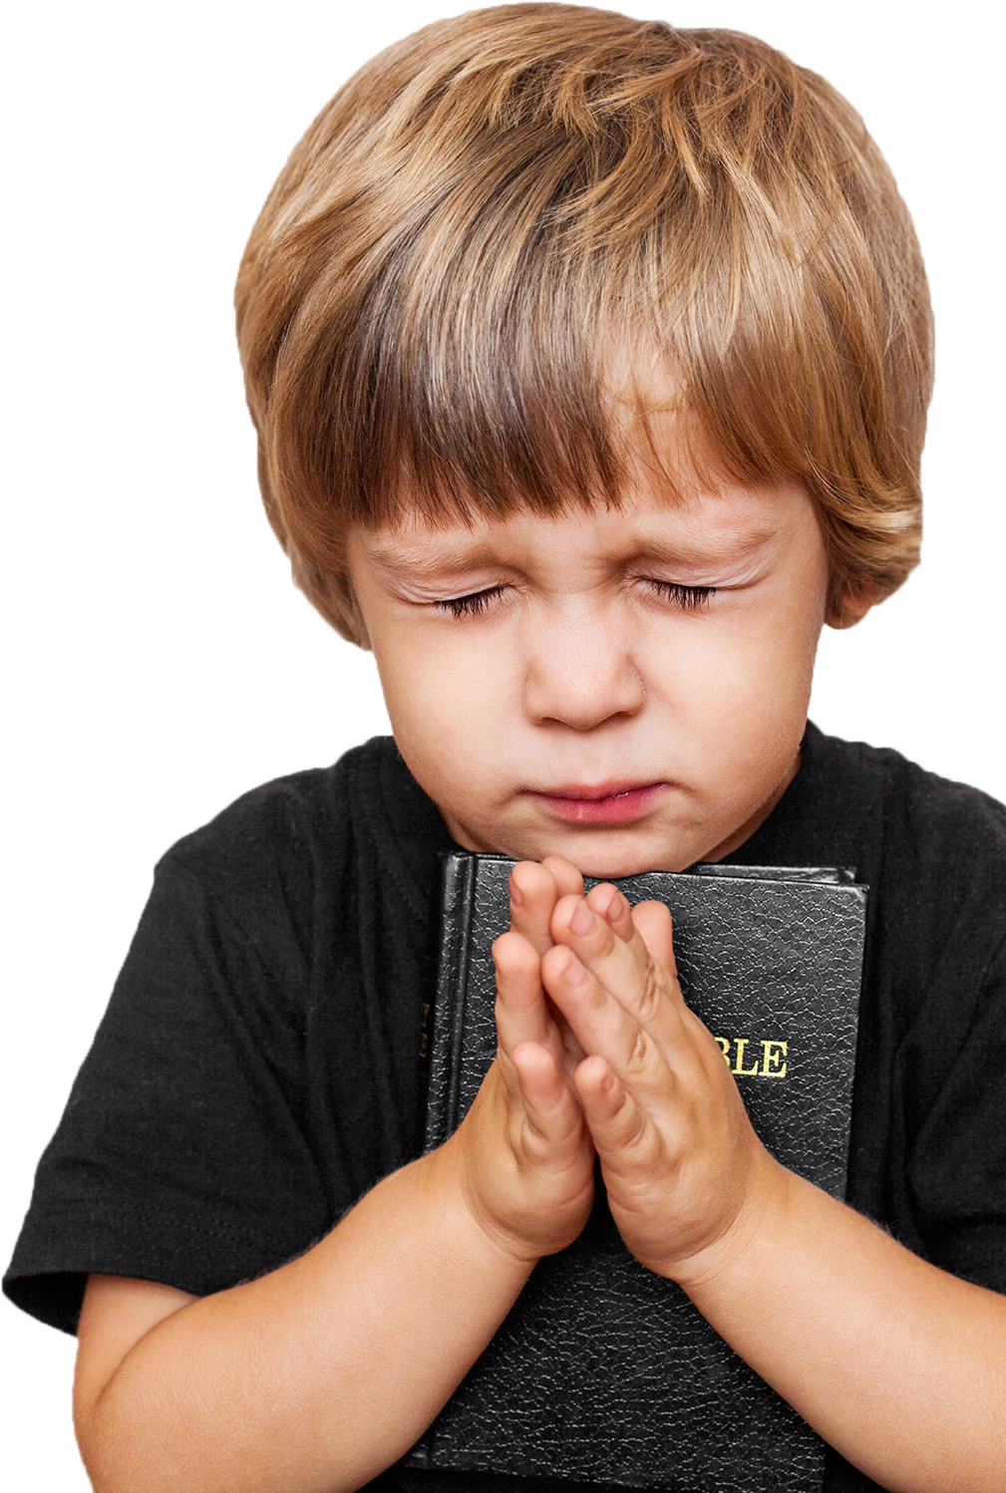
HIS PROVISIONS ARE UNCHANGEABLE – “Whatever is good and perfect is a gift coming down to us from God our Father, who created all the lights in the heavens. He never changes or casts a shifting shadow.” (James 1:17)
Our God who heard the cries for help & provided for the heroes of the Bible will hear your cries & provide for you. (Phil 4:19).
“The will of God will not take us where the grace of God cannot sustain us.” (Billy Graham)
“God always gives His best to those who leave the choice with him.” (Jim Elliot)
“God has never failed in his promise to supply my need, so I cannot fail in my service to Him.” (William Carey)
Notes:
He is the creator of the heavens so his resources are infinite. He is unchanging so they are guaranteed. He knows how to give good gifts and will even surprise us with more than we expect. In the wilderness he gave his people springs of water, bread each morning and quail to eat – more than they could eat. He sent ravens to give Elijah meat etc. etc. I am sure we all have stories to share as to how God has met our needs in amazing ways. God has a purpose for you - be confident that he will provide from his extraordinary riches. God has called each of us to a unique purpose and he will equip us to do that. We still have to do our part but he will provide. We must let him decide our ‘needs’ as he knows best.

Slide 6
HIS CHARACTER IS UNCHANGEABLE – “If we are unfaithful, he remains faithful, for he cannot deny who he is.” (2 Timothy 2:13)
He is just, righteous, faithful, patient (long suffering), truthful, merciful, holy, good, loving, generous, gracious, merciful, forgiving, all powerful, all knowing, all present ….
The God we worship today, is the same God who created the universe. We change, but He is perpetually the same, the great I AM.
“He can’t change for the better because he is completely perfect. And being perfect he can’t change for the worse.” (C Spurgeon)
Notes:
He can’t tolerate sin and let it go – just and holy. He can’t just let us perish – loving, merciful and gracious. He is the God of second chances. He is not subject to a whim, pressure, social change etc.

Slide 7
HIS GOOD NEWS IS UNCHANGEABLE – “The earth and heavens you made…will perish, but you remain forever…. You will change them like a garment and discard them….The children of your people will live in security. Their children’s children will thrive in your presence.” (Psalm 102:28)
God is unchangeably just and holy = rebellion and sin has to be judged & death (forever separated from him) is the penalty (Gen 2:17, Ezek 18:4, John 8:24, Rom 6:23, James 1:15 & Rev 20:15).
God is unchangeably gracious, merciful and loving and longs for us to be in heaven with him (2 Peter 3:9) – to be part of his eternal kingdom and forever in his presence.
Notes:
The Psalmist closes on the highest note possible – while this changing and uncertain world won’t last, the greatest joy and hope we have is that we have the promises of living with our unchangeable God forever. He is more committed to us then the greatest mountains and oceans. But to do this God has a problem to deal with. Our sin and God’s unchangeable character create a problem for us. Sin has to be judged and death penalty given – Bible never waivers from that, consistent through the whole book. His unchangeable justice and holiness means he has to deal with sin (can’t overlook it, disregard it, modify it) and that judgment = condemnation and death.
But on flipside God’s unchangeable grace and mercy means he doesn’t just want to let us die. How he solves that problem is the essence of the gospel, the unchanging good news. To appreciate the good news, we have to preach the bad news. To appreciate the extent of God’s love and the wonder of heaven we have to understand the depth of our sin and wickedness (how undeserving we are) and the horror of hell. John Wesley, great preacher in England once said Preach 90% law and 10% grace. Too often churches and Christians fall into the trap of preaching grace and salvation without law, sin and death.

Slide 8
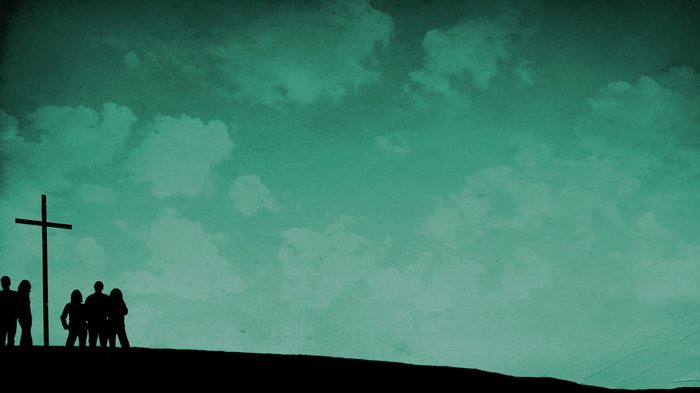
How God solves this problem = the good news (gospel). Before we preach love, mercy & grace we must preach sin & death - the whole truth and nothing but the truth.
The cross = God’s unchangeable justice is satisfied and His unchangeable grace and mercy is revealed.
The cross = Jesus took our suffering and death and we received his righteousness & salvation (eternal life).
Repenting & accepting Jesus as Saviour & Lord = we are children of God. He can look at us & we can enter His presence + He is faithful to us & will love us past the ending of this world - for eternity.

Slide 9
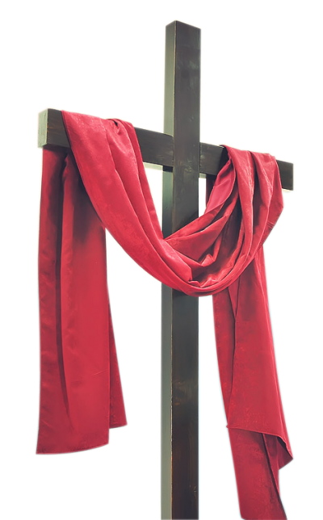
“Tell me Charles, what’s the good news today?” (Lloyd Douglas)
“That’s middle C! It was middle C yesterday. It will be middle C tomorrow and it will be middle C a thousand years from now. The tenor upstairs sings flat, the piano across the hall is out of tune, but, my friend, THAT is middle C!” (Charles)
Jesus is our Middle C in this out of tune, ever changing & disintegrating world. He is the same yesterday, today & forever.
In these tough & changing times may we look to our unchanging God. Find peace, joy, comfort & hope in his unchanging PROMISES, PURPOSES, PROVISIONS, CHARACTER & TRUTH.
Notes:
When Lloyd C. Douglas, author of The Robe and other novels, was a university student, he lived in a boarding house. Downstairs on the first floor was an elderly, retired music teacher named Charles who was suffering early dementia and unable to leave the apartment. Douglas said that every morning they had a ritual they would go through together. He would come down the steps, open the old man’s door, and ask, “Well, what’s the good news?” The old man would pick up his tuning fork, tap it on the side of his wheelchair and say, That’s middle C! It was middle C yesterday; it will be middle C tomorrow; it will be middle C a thousand years from now. The tenor upstairs sings flat, the piano across the hall is out of tune, but, my friend, THAT is middle C!”

