Slide 1
My God is so big, so strong and so mighty, there's nothing my God _________.
cannot do
“..for God cannot deny who he is.”
(2 Timothy 2:13)
The God who can’t do some ‘things’ is more awesome than the God who can do everything.
The things God can’t do = a Happy New Year for His children in 2023 and beyond.
Notes:
For those of us who grew up in Sunday School we may remember one of the classic kids praise songs. My God is so big, so strong and so mighty, there’s nothing my God _______. Finish the sentence = cannot do. But in reality that song is not really true because there are things God can’t do. Before you brand me a blasphemer you need to realise that the Bible says that itself – in 2 Timothy 2:13. We will look at that in more detail in later messages. But today we are starting a small holiday series for January where will look at the things God can’t do and see how that is a good thing for all followers of Christ . It means we can enjoy a Happy New Year in 2023 and beyond (until Christ comes).

Slide 2
GOD CANNOT LEARN AND GOD CANNOT BE SURPRISED (PSALM 139)
GOD’S PRESENCE IS AN INESCAPABLE FACT.
GOD’S PRESENCE CAN BE A RADICAL THREAT.
GOD’S PRESENCE BRINGS US PRECIOUS COMFORT & JOY.

Slide 3
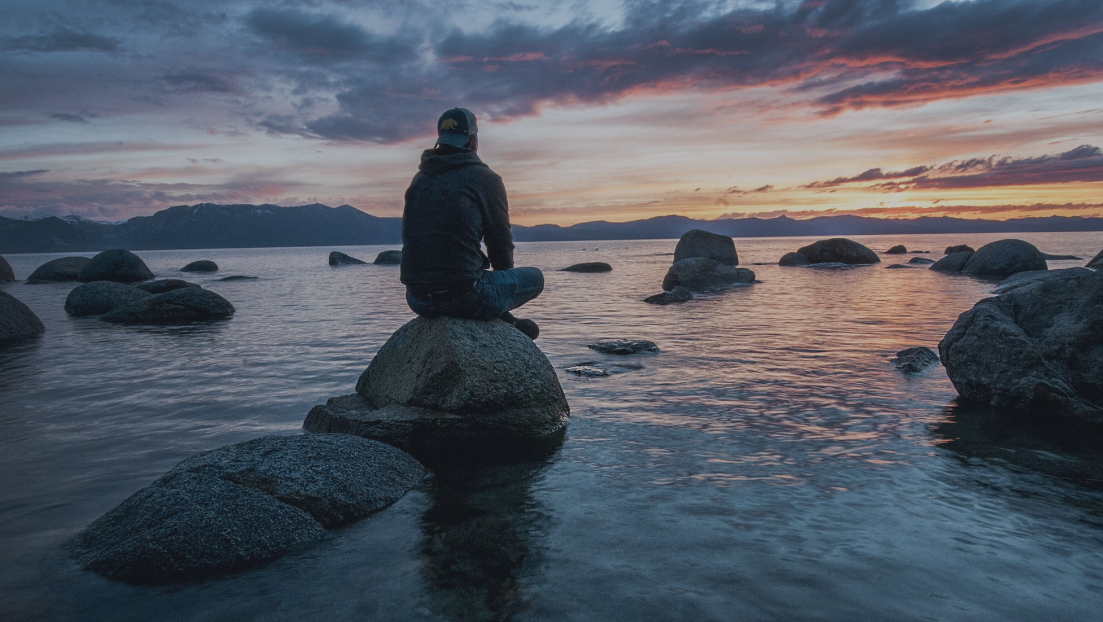
GOD’S PRESENCE IS AN INESCAPABLE FACT.
A. His knowledge surrounds us = He knows everything about our heart (v1), our actions and thoughts (vs 2-3) and our words (v4) = He knows everything about our life – intimately & infinitely more than we know ourselves.
All of our past, present and future are present to God - He sees all moments happening at once. He is timeless = independent and outside of time.
His intimate & infinite knowledge of us = He can’t learn anything new about us + we can’t surprise Him.
Notes:
David points out this inescapable reality in three ways. A. Firstly, God’s knowledge surrounds us. He knows everything about our heart, our passions, our desires, our hurts, our pain, our fears – everything we feel. He knows our motives and behaviour – everything we think and do. He knows every word we say (even before we say them). He knows us intimately (individually) and infinitely better than we know ourselves. He sees our past, present and future – when we are young, middle aged and old. He sees your yesterday, today and tomorrow. Not by sitting in the past and foretelling the future – he is present in every moment.

Slide 4
B. His presence surrounds us = we can’t escape Him (v7), He is the heavens and the grave (v8), in distant seas and lands – every direction (v9) and in darkness (vs 10-11).
Presence (face) = all of Him, He is completely present in every point in space = He can’t learn or be surprised.
C. His power surrounds us = He created, sustains and upholds our body and soul (v13) and He alone decides the number of days we live (v16) = value, love & purpose.
Creating, sustaining, upholding & ordaining = He can’t learn or be surprised. He knows the future because he has already been there.
Notes:
B. His presence surrounds us – not just spread out like gas (when you spray a can) – that is just molecules broken down and spread out. He is fully present in every point in space. C. His power surrounds us – he created us, he planned our gender, size, shape, hair colour, eye colour, personality etc. Life from the very beginning in the womb to the very end at death is ordained by God. Not for us to decide with abortion and euthanasia. To do that is to put yourself in the place of God, putting yourself on the throne of God. John the Baptist (Luke 1:15) and Jeremiah (Jeremiah 1:5) were called when they were in the womb, filled with the spirit in the womb. Made in the image of God, given purpose, valued and loved in the womb. God creates, upholds and sustains our life and our history. So even when you are old and question why you are still here – trust God still has purpose for you (not always easy to see that).

Slide 5
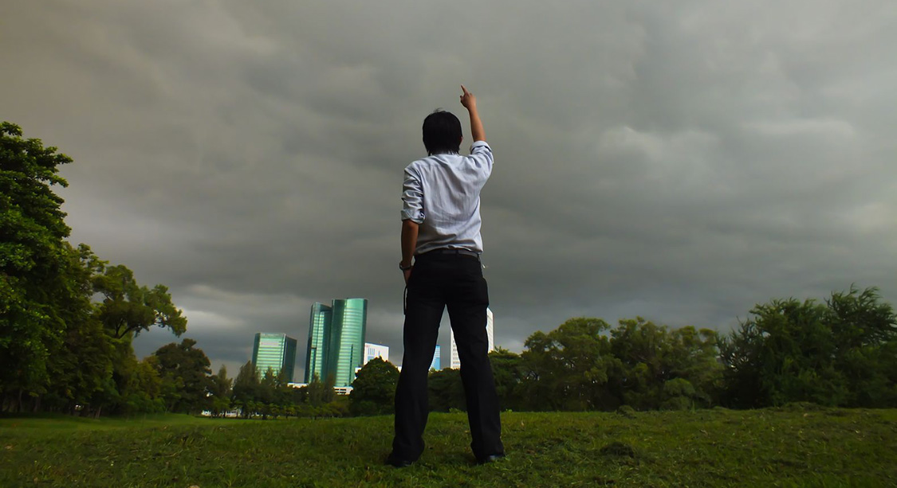
GOD’S PRESENCE IS A RADICAL THREAT.
A. It can be suffocating & threatening to us – “You go before me and follow me (hem me in)… Such knowledge is too wonderful for me, too great for me to understand.” (vs 5-6)
“If there is a god who sees everything, knows everything and ordains everything, then the future is set and we can’t be free. We are dehumanised.” (Jean Paul Sartre)
B. “I can never escape from your Spirit. I can never get away from your presence.” (v7) Sinful humans love self determination - how we live, right & wrong. No freedom = meaningless life.
Notes:
For the sinful, human heart the presence, knowledge and power of God is a huge threat. It is all too much to deal with. In verses 5-6 it sounds positive – too wonderful, too great. But in reality its more like I can’t handle this. The NIV translates “before” and “follow” as hemming me in – suffocating me. That suffocation and threat lead David to sometimes strive to flee God’s presence. David sometimes tried to do things his way - a good example was affair with Bathsheba. , Jonah tried it too (not wanting to see Nineveh saved) – they both found it tough and there will be times when we will too. Our culture tells us that a meaningful life is doing what you want when you want. Jean Paul Sartre is a French philosopher and playwright who shared the idea of an all powerful, present and knowing God. Both David and Jonah rebelled against God’s presence, power and will – but on both occasions God chased after them and bought them back.

Slide 6
GOD’S PRESENCE BRINGS US PRECIOUS COMFORT & JOY.
“How precious are your thoughts about me, O God. They cannot be numbered.” (v17)
A. “Your hand is always there to guide me and your strength will support me.” (v10) = God makes sure you won’t stay lost or stay down after you stumble. He will always pursue you - He will never abandon you.
“The problem I have with my desire to be free and have no god, is that I have nothing outside of myself that I can depend on. I have no one to guide me or to hold onto. Its all up to me.” (Jean Paul Sartre)
Notes:
In this Psalm we see how David changes his mind on the presence of God – he moves from being threatened and wanting to flee from God to rejoicing in his presence – in the fact he can’t learn or change his mind. He finds comfort and joy that can only be found in knowing that god. He is excited by the presence of God. He changes from let me out of here to rejoicing in the presence of God. He rejoices in the fact that God will always be with him – guiding and lifting him up again when he falls. When things are going wrong we can often think that God has abandoned us. But in reality those times are often the times God is pursuing you – I know that has been true in my life when I look back on those tough moments.

Slide 7
B. “To you the night shines as bright day. Darkness and light are the same to you.” (v12)
Darkness in Psalms = suffering, danger, disease, terror and threat of death = uncertainty, anxiety & despair. But God is bigger & never surprised – we’re safe & can be optimistic. He’s always present & holding our hand.
C. “When I wake up you are still with me.” (v18) – Why mention sleeping again – already mentioned in verse 3?
“When I awake, I will see you face to face and be satisfied.” (Psalm 17:15) Death is our greatest threat, but God’s hand can reach through that & pull us free – see Mark 5:41.
Notes:
B. God is never going to be surprised by darkness – and he is always bigger than any threat we face. We live in an uncertain world, filled with despair – interest rates, climate change, cost of living, global tensions. Anxiety around the world is palpable. In a world that rejects God, there is no hope in darkness.
C. Sleep – this time he is talking about waking up after death. See him talk like this in Psalm 17:15. Bible often refers to death as sleep. See this in Mark 5:41 when Jesus went to the bedside of the daughter of a synagogue leader who had died. He said she isn’t dead, just asleep. Then took her hand and said little girl get up, and she did. When we love God, death is not the end.

Slide 8
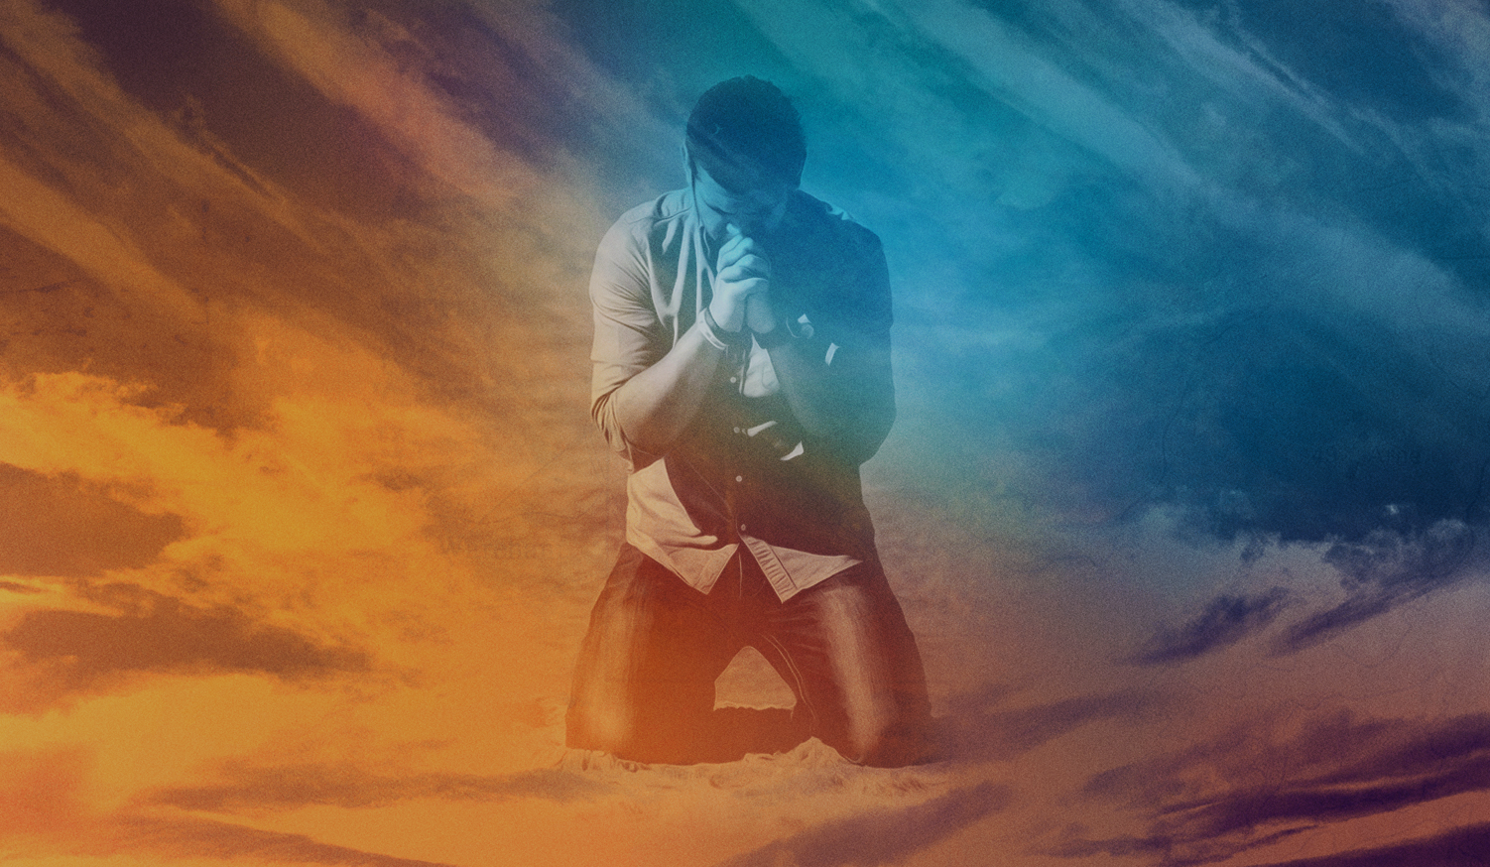
How does David go from considering God’s presence to be smothering, confronting and threatening to being precious – giving comfort, peace & joy? How does he go from wanting to run away from God to wanting to be in His presence?
He deals with the issue of sin – hating it in others (vs 19-22) leads him to deal with the sin in his life. “Search me, O God …point out anything in my life that offends you.” (vs 23-24)
We can’t get the presence of God unless we deal with our sin – “Your sins have separated you from your God and hidden his face from you..” (Isaiah 59:2)
God sent Jesus to deal with our sin = love, grace & mercy.
Notes:
Like David we struggle with being observed, being held accountable for everything – wanting to have the freedom to do what he wants, to rule his own life (just like we all do and have so since Adam sinned). He invites scrutiny into his own life

Slide 9
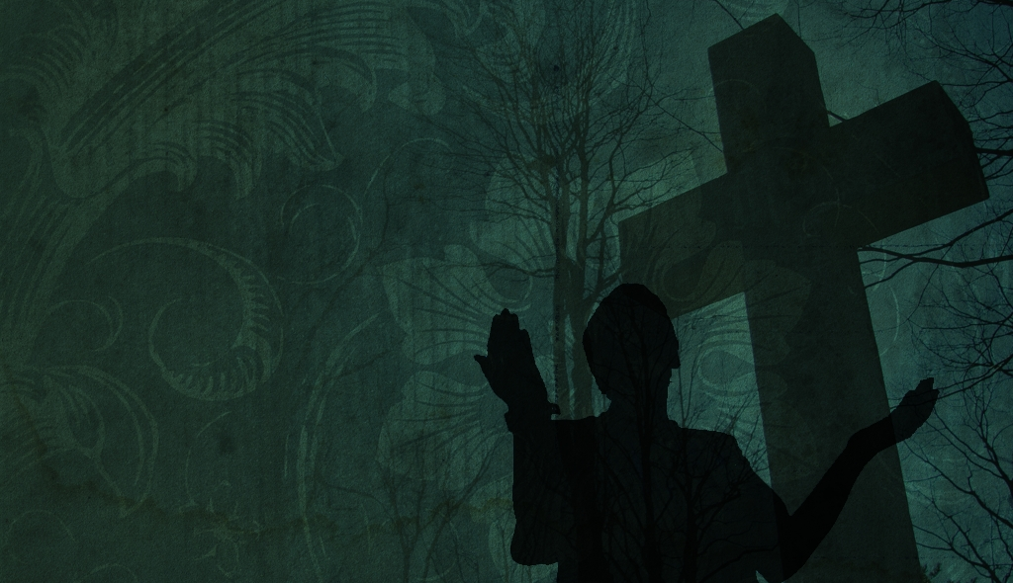
Jesus deals with our sin in the ultimate way. He took our darkness, our sin and our judgment and experienced God turning his face away so that we could be saved.
In 2023, trust your future to the God who knows you intimately and who knows the future perfectly (He’s already been there).
Happy New Year = find your peace, comfort, hope & joy in -
the God who is all knowing, all present and all powerful.
the God who wins in the end, and
the God who promises His children, “I will never fail you and I will never abandon you.” (Heb 13:5)
Notes:
We are loved, not because we deserve it but because of his love, grace and mercy. Jesus died for us despite our sin, darkness and rebellion (not just for our Sunday best version.) He can’t learn or be surprised by us. God knows our deepest and darkest secrets but still loves us enough to send Jesus.

